Slide 1






















SYMPTOMS
ISSUES
Regulatory agencies
Implementing partners
Donors
SOLUTIONS
Tertiary care
Development banks
Domestic government
Referral care
TOOLS
Domestic private sector
Global private sector
Primary care
CHW
FRAMEWORK
Woman & child
Dispensary
Distribution
Procurement
Manufacturing
R&D
Financing Framework to End Preventable Child and Maternal Deaths
Summer 2015
LOCAL
SUB-NATIONAL
NATIONAL
GLOBAL

Slide 2
Table of contents
Towards Sustainability: Introduction to the Financing Framework for EPCMD
The Financing Framework
Resources to apply the Financing Framework
Identifying symptoms, underlying financing issues, and solutions
Tools to enable solutions: when and how they apply
Case study library

Slide 3
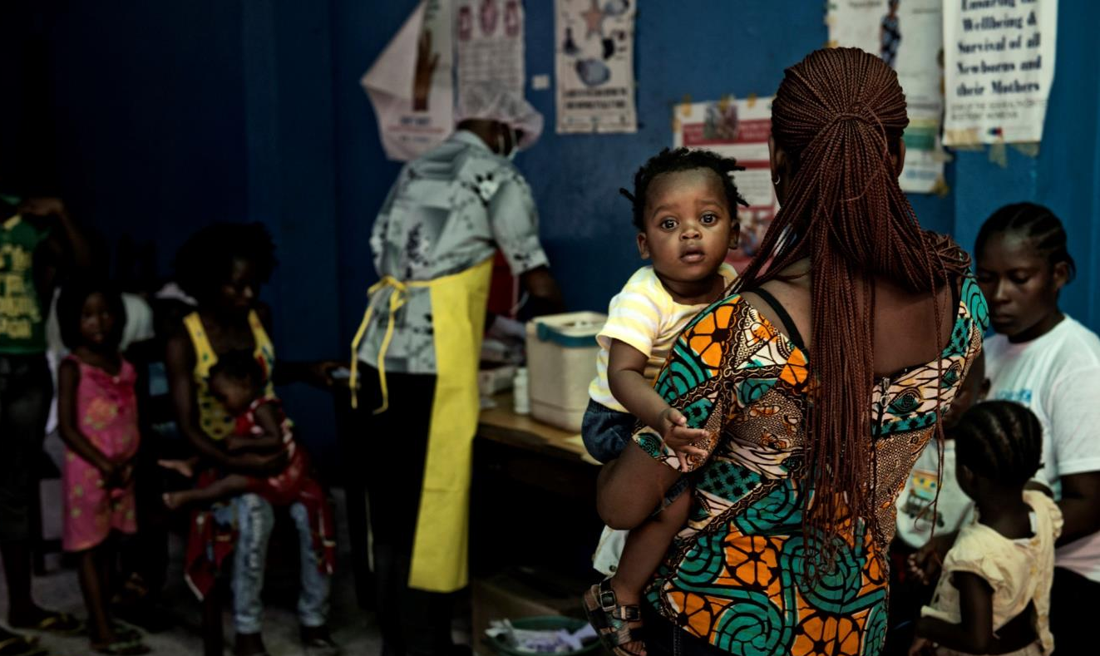
The EPCMD Financing Framework outlines ways USAID can support the transition to sustainably-financed health systems
Principles for the
EPCMD Financing Framework
A sustainable financing approach for ending maternal and child deaths will:
Prioritize equity in health service delivery, and support models that reduce the share of health expenditure shouldered by the poor and maximize use of funds;
Aim towards sustainable domestic financing, both public and private, in line with economic growth;
Recognize that there is no one-size-fits-all model, and that the path to self-financing will not be uniform across countries
Source: USAID (2015): Financing Framework Concept Note; Neil Brandvold for USAID (photo); Dalberg analysis.
3

Slide 4
This Financing Framework is a first step toward achieving these dual EPCMD and transition goals
✓
The Financing Framework does…
✗
The Financing Framework does not…
Promote the broad understanding of financing tools and their potential to accelerate progress toward EPCMD goals and help countries transition to self-financing
Prioritize results and equity through the lens of ultimate self-financing
Accelerate use of financing instruments in countries that are graduating or close to graduating to middle-income status
Complement the ongoing efforts of the Global Financing Facility
Serve as an official strategy with specific targets and budget asks
Cover all aspects of financing for global health
Attempt to replicate other efforts in the space; instead, it draws from best practices already being used by the Agency and its partners
Dictate programming
The Financing Framework explores financing opportunities to improve EPCMD funding flows, and considers their applicability to USAID’s strategy for maternal and child survival

Slide 5

The United States has made bold commitments to ending preventable maternal and child deaths globally
Creation of the Millennium Development Goals
2000
GAVI
The United States is committed to ending preventable newborn, child, and maternal deaths in a generation.
2001
2002
The Global Fund
2003
2004
2005
2006
UNITAID
2007
Health Results Innovation Trust Fund
2008
2009
World Health Report on Health Systems Financing – the path to universal coverage
2010
Every Woman Every Child
UN launches Global Strategy for Women’s and Children’s Health
2011
UN General Assembly passes resolution on Universal Health Coverage
2012
UN Commission for Lifesaving Commodities
Child Survival Call to Action hosted by USA, UNICEF, Ethiopia, & India
2013
Acting on the Call: 2nd anniversary of the Child Survival Call to Action
2014
UN General Assembly to introduce Sustainable Development Goals
2015
Global Financing Facility
Source: Every Woman Every Child (2015): “Saving Lives, Protecting Futures Progress Report;” Expert interviews; Dalberg analysis.

Slide 6
However, our maternal and child survival goals will not be achieved by 2035 without mobilizing additional resources for health
*
The EPCMD resource gap is currently $27 billion in high burden low- and lower-middle-income countries
This gap will decrease over time as economic growth fuels domestic resource mobilization
This gap will range from $4-8 billion in 2030, depending on domestic government RMNCAH spend
*Note: South Sudan not included in analysis due to lack of data. Source: World Bank (2014): “GFF Concept Note;” USAID (2014): “Acting on the Call Report;” Dalberg analysis.

Slide 7
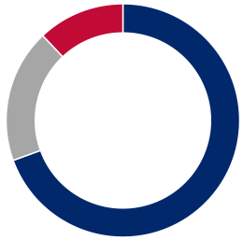
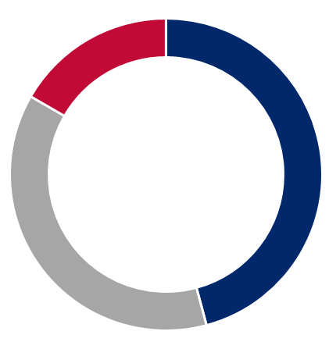
Alongside achieving EPCMD goals, USAID envisions transitioning toward sustainably financed health systems
DONOR DEPENDENCE
Traditional: Development assistance for maternal, newborn, and child health surpassed $6 billion in 2011; much of this assistance is in the form of grants, upon which many LMICs are dependent
Decrease
donor dependence
Transitional: Donors gradually sunset grants, increase the use of financing instruments to facilitate country-led transition to more sustainable health budgets, and reserve grant-based aid for global public goods and the last mile
Reduce
out-of-pocket spend
Increase domestic
resource mobilization
DOMESTIC EXPENDITURES
Traditional: Many LMICs spend less than 15 to 30% of their government budget on health (Abuja Declaration target); many opportunities for private sector mobilization go unrealized
TRADITIONAL
(TODAY)
Transitional: Through taxation and transparency programs, budget allocation efforts, and private sector mobilization, domestic public and private sectors increasingly replace donor funding
TRANSITIONAL
OUT-OF-POCKET EXPENDITURES (OOP)
Traditional: Out-of-pocket spending makes up over 40% of average total health expenditure in low-income countries, putting the poorest at risk of health-related financial catastrophes
SUSTAINABLE
(2035 AND BEYOND)
Transitional: Transitional support plans should ensure that out-of-pocket spending decreases to less than 20% of total health expenditure (e.g., through universal health coverage)
Source: IHME (2013): “Financing For Global Health 2013;”WHO (2011): “The Abuja Declaration;” WHO (2014): “Global Health Expenditure Database; WHO (2006): “Exploring the thresholds of health expenditure for protection against financial risk;” Dalberg analysis.

Slide 8
Towards Sustainability: Understanding where we are and what we need to get there
TRADITIONAL
(2015)
TRANSITIONAL
SUSTAINABLE
(2035 and beyond)
Currently, the majority of donor budgets go toward grants to implementing partners
To begin, consider which underlying financing issues are currently most impacting your country’s progress toward EPCMD goals
Connect with resources within the Agency that can help you decide which tools might be right to try, and weigh the pros and cons of each before moving forward
Reach out to others at the Agency, within and outside health, to understand how they think about and use financing tools at their mission, and identify opportunities for learning and collaboration
In program design and planning cycles, actively consider the transition to sustainable finance
Increase direct use of tools (e.g., DCA) and experiment with creative applications to the health sector
Work with other stakeholders, such as domestic governments and implementing partners, to implement new tools indirectly
Plan for a self-financed future through building graduation plans for EPCMD on a country-by-country basis
Consider the enabling environment required to facilitate the use of tools, and collaborate with other parts of the Agency to find solutions
Many countries (with the exception of fragile or conflict states) are no longer donor-dependent; some have achieved MDG maternal and child mortality targets
Health outcomes are equitable, and even the poorest can access quality care without financial burden
If USAID maintains a presence in the country, funds are focused on new health priorities, and directed at reaching last mile populations in a sustainable way
Sustainable financing tools are used in a small share of EPCMD programming today, but will be key to navigating the transition to self-financed health systems

Slide 9
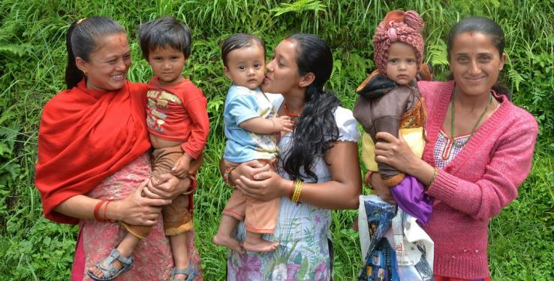
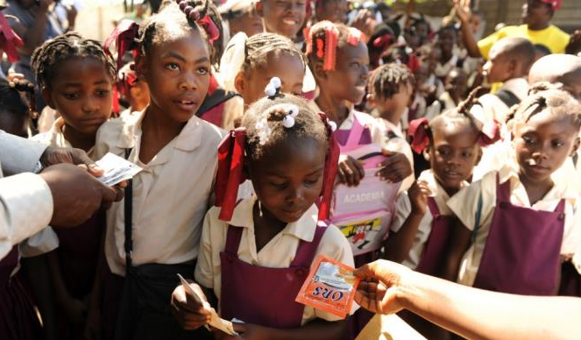

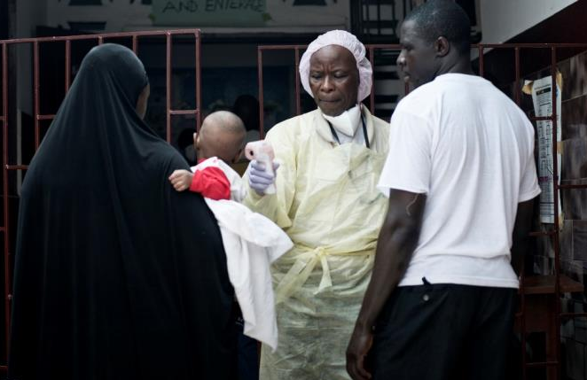


It was developed through a collaborative process that sought to identify best practices within the Agency and beyond
  We THANK all the Partners and Agency staff who participated in developing this Financing Framework.

Slide 10
Table of contents
Towards Sustainability: Introduction to the Financing Framework for EPCMD
The Financing Framework
Resources to apply the Financing Framework
Deep dive on symptoms, underlying financing issues, and solutions
Tools to enable solutions: when and how they apply
Case study library

Slide 11
The Financing Framework promotes an understanding of how different financial tools support EPCMD and transition goals
SYMPTOMS
IDENTIFY SYMPTOMS
DIAGNOSE ISSUES
ASSESS SOLUTIONS
EXECUTE TOOLS
ISSUES
Certain symptoms in EPCMD, felt across the health system, may be evidence of an underlying financing issue
Example: Frequent stock-outs at local dispensaries are causing disruptions in care
These symptoms can be indicative of underlying financing issues that disrupt progress toward both EPCMD and transition goals
Example: Working capital gaps throughout the supply chain lead to delayed payments, and subsequently stock-outs
Each of these issues can be addressed through a set of solutions; assessing the conditions under which solutions may work is critical before execution
Example: There is a solution space around increasing lending to the private sector to smooth working capital gaps
There is a set of financing tools that USAID and its partners can use to enable solutions
Example: Guarantees to local banks can encourage increased lending to private health providers, dispensaries, or distributors
SOLUTIONS
TOOLS
FRAMEWORK
The Financing Framework is a learning resource for USAID and partners to demonstrate the potential value of financing tools by linking them to EPCMD and transition goals

Slide 12





SYMPTOMS
…and provides missions with a clear pathway to understanding when and how financing tools can be applied
SYMPTOMS INCLUDE:
ISSUES INCLUDE:
SOLUTIONS INCLUDE:
TOOLS INCLUDE:
ISSUES
Decreasing national health budget
High donor dependence for health
High OOP spending
Insufficient domestic resources or political will for EPCMD, from both public and private sources
Improved budget allocation
New government revenue sources
Trust funds
Taxes and levies
Lending
Limited growth in the private health sector
Long wait times
Low-quality care
Lack of provider incentives to provide affordable, quality care to the poor
Increased private investment in market-based solutions
New outcome-based incentive structures
Development impact bonds
Public private partnerships
SOLUTIONS
Frequent stock-outs of critical commodities
Delayed health worker payments
Working capital gaps throughout the supply chain, leading to stock-outs and payment delays
Increased bank lending to the private health sector
Guarantees
TOOLS
High absenteeism rates
Health worker strikes
Informal payments from consumers
Delayed and incomplete health worker salaries, limiting incentives to provide care
New mechanisms to improve payment logistics
Payment systems
Patients seek urgent, not preventative, care
Catastrophic household health expenditures
Limited ability to pay for EPCMD products and services, restricting utilization among the poor
Expanded microfinance health products
Increased consumer resources for healthcare
Risk pooling mechanisms
Guarantees
Pay for performance
FRAMEWORK

Slide 13














EPCMD products and services are produced and delivered through complex health ecosystems
SYMPTOMS
Illustrative health ecosystem*
ISSUES
Public and private health delivery
Commodities value chain
Regulatory agencies
Implementing partners
Key financing sources
Donors
SOLUTIONS
Tertiary care
Development banks
Domestic government
Referral care
TOOLS
Primary care
CHW / Health workers
Domestic private sector
Global private sector
FRAMEWORK
Woman & child
Dispensary
Distribution
Procurement
Manufacturing
R&D
LOCAL
SUB-NATIONAL
NATIONAL
GLOBAL
*Note: Not exhaustive; health systems vary considerably by country, and involve a complex set of players

Slide 14
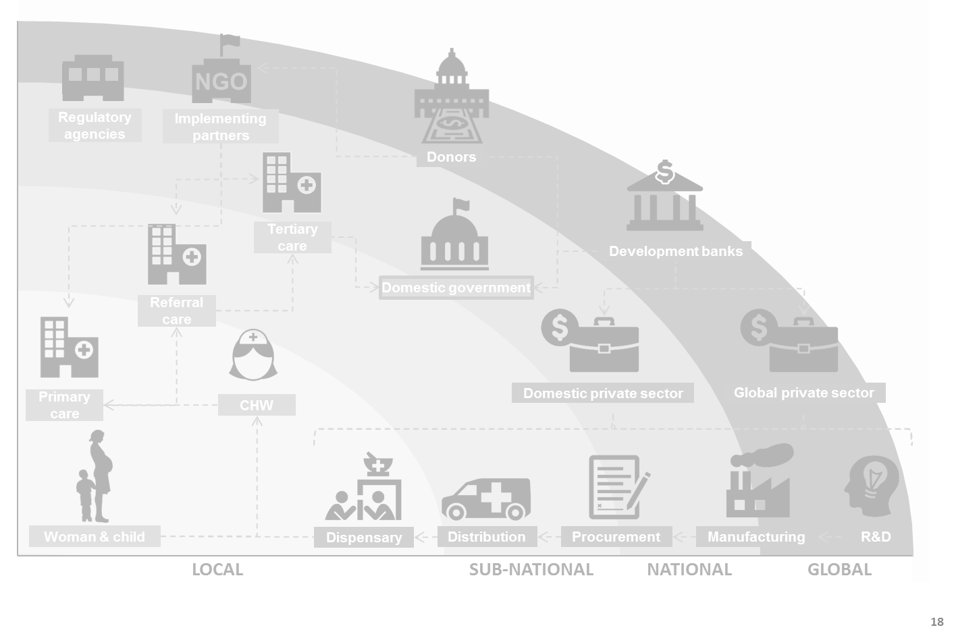
A variety of symptoms exist within the health ecosystem that may indicate underlying financing issues that hinder our health goals
SYMPTOMS
ISSUES
Limited demand for care across health system
Outdated and non-functional equipment
Limited growth in private
health sector
SOLUTIONS
Funding gaps for EPCMD programming
High donor dependence for health
Long wait times
Needs upgrades
Banks refuse to lend to health sector
Poor quality
of care
Absenteeism among health workers
TOOLS
Seeks urgent instead of preventative care
Frequent stock-outs
Emergency procurements
Limited demand for key drug
Recommends incorrect drug
FRAMEWORK
Poor health outcomes
LOCAL
SUB-NATIONAL
NATIONAL
GLOBAL
Source: Expert interviews; Dalberg analysis.

Slide 15

The Framework identifies five common financing issues that are often causes of these symptoms
SYMPTOMS
ISSUES
Insufficient domestic resources or political will for EPCMD from both public and private sources
Leads to funding gaps across the value chain, constraining the ability of the health system to deliver sufficient care
Lack of provider incentives to provide affordable, quality care to the poor
Results in long wait times and poor service delivery in both public and private health systems
SOLUTIONS
Delayed and incomplete health worker salaries, limiting incentives to provide care
Results in high levels of absenteeism and low quality service delivery
Working capital gaps throughout the supply chain and health ecosystem
Results in stock-outs and payment delays
TOOLS
Limited ability to pay for EPCMD products and services, restricting utilization and access among the poor
Leads to low demand for services and catastrophic household spending when care is sought
FRAMEWORK
Source: Expert interviews; Dalberg analysis.

Slide 16
The Financing Framework considers how and when these symptoms may be evidence of an underlying financing issue…
SYMPTOMS
Symptoms include: | Financing issues | Alternative explanations include:
High donor dependence for health | Insufficient domestic resources or political will for EPCMD, from both public and private sources | Extremely low-income or fragile economy
High percentage of out-of-pocket spending |  | Lack of coordination
Funding gaps for EPCMD programming
 |  | Limited capacity to absorb funding
Limited growth in private health sector | Lack of provider incentives to provide affordable, quality care to the poor | Strong public delivery systems
Low quality care in public and private facilities |  | Insufficient training for health workers
Long wait times |  | Lack of health workers
Frequent stock-outs | Working capital gaps throughout the supply chain, leading to stock-outs and payment delays | Broken supply chains; poor forecasting
Delayed health worker payments |  | Payment logistics challenges
Absenteeism among health workers | Delayed and incomplete health worker salaries, limiting incentives to provide care | Insufficient non-financial incentives
Frequent health worker strikes |  | Insufficient funding for salaries
Informal payments from consumers |  | Lack of transparent payment systems
Low utilization of EPCMD interventions | Limited ability to pay for EPCMD products and services, restricting utilization among the poor | Unavailability or unreliability of service providers; cultural norms
Patients seeking urgent instead of preventative care |  | Inaccessibility of service providers; lack of knowledge
Catastrophic household health expenditures |  | Lack of innovation in low-cost models
ISSUES
SOLUTIONS
TOOLS
FRAMEWORK
Source: Expert interviews; Dalberg analysis.

Slide 17
…relates each underlying financing issue to potential solutions…
SYMPTOMS
Issues | Solutions include: | Examples
Insufficient domestic resources or political will for EPCMD, from both public and private sources | Improved government budget allocation to EPCMD New government revenue sources Increased government borrowing for health | Bonds Concessional loans Health budget increases
Lack of provider incentives to provide affordable, quality care to the poor | Increased private investment to scale market-based solutions Greater incorporation of private provision into public health schemes Increased consumer resources for healthcare New outcome-based incentive structures | Investment funds Public-private partnerships Performance-based incentives
Working capital gaps throughout the supply chain, leading to stock-outs and payment delays | Increased bank lending to the private health sector | Debt facilities for providers and distributors
Delayed and incomplete health worker salaries, limiting incentives to provide care | New mechanisms to improve payment logistics | Mobile payments
Limited ability to pay for EPCMD products and services, restricting utilization among the poor | Increased consumer resources for healthcare New national policies to improve access to care New or expanded health savings, lending, and insurance products | Vouchers Health insurance schemes
ISSUES
SOLUTIONS
TOOLS
FRAMEWORK
Source: Expert interviews; Dalberg analysis.

Slide 18





…and explores how financing tools can enable these solutions
SYMPTOMS
Domestic
resources
Provider incentives
Working capital
Delayed salaries
Ability
to pay
ISSUES
Relevant financing issues |  |  |  |  | Solution | Tools
 |  |  |  |  | Improved government budget allocation to EPCMD | Trust funds
 |  |  |  |  | New government revenue sources | Improved tax collection system
 |  |  |  |  | Increased government borrowing for health | Lending (including bonds and concessional loans)
 |  |  |  |  | Increased private investment to scale market-based solutions | Investment funds
 |  |  |  |  | Increased bank lending to the private health sector | Guarantees
 |  |  |  |  | Greater incorporation of private provision into public health schemes | Public-private partnerships
 |  |  |  |  | New outcome-based incentive structures | Pay for performance mechanisms e.g. development impact bonds and vouchers
 |  |  |  |  | New national policies to improve access to health care including new/expanded health savings, lending and insurance | Risk pooling mechanisms; investment funds; guarantees
 |  |  |  |  | New mechanisms to improve payment logistics | Payment systems
✓
✓
✓
✓
✓
✓
✓
✓
SOLUTIONS
✓
✓
✓
✓
✓
✓
✓
✓
✓
✓
✓
✓
✓
TOOLS
✓
✓
✓
✓
✓
✓
✓
✓
✓
✓
✓
✓
✓
FRAMEWORK
✓
✓
✓
Source: Expert interviews; Dalberg analysis.
First-order impact
Second-order impact

Slide 19
There is a growing set of financing tools with potential for greater application to EPCMD programs
SYMPTOMS
Tool | Definition
Guarantees | A DCA credit guarantee offers partial protection for lenders willing to enter and deploy capital (e.g. working capital) into developmentally important sectors like health. At USAID, guarantees can be arranged with sub-sovereign public sector and private sector entities (e.g. NGOs and non-profits), but not sovereign entities.
Lending | Lending includes bonds (e.g. diaspora bonds, health systems bonds), concessional loans, local currency loans, notes, and facilities. Bonds can be used to frontload access to ODA by leveraging long-term commitments to smooth financing flows.
Investment funds | Impact and other investment funds pool funds from socially responsible individuals and institutions and make investments that aim to solve social or environmental challenges, while generating financial returns.
Taxes and levies | Countries can strengthen and improve tax administration and collection processes for the purpose of increasing resources allocated to health.
Public-private partnerships (PPP) | Government service or private business ventures are funded and operated through a partnership of government, and one or more private sector companies, and other partners, such as NGOs.
Pay for performance (P4P) | Specific objectives are outlined when a financing agreement is made with a contractor. Funds are disbursed according to how closely these objectives have been met. Can be used to incentivize individual behavior change to increase demand for and use of services. They can also be used to incentivize innovation in a delivery system.
Risk pooling mechanisms | Health insurance schemes (e.g. national, micro, employee-sponsored) pool risk among consumers to improve efficiency and predictability of spending.
Payment systems | Payment systems include mechanisms that improve the efficiency and accuracy of payments within a health system (e.g. mobile payment platforms for community health workers).
Corporate social responsibility (CSR) | Companies integrate social/development issues into their business operations.
Trust funds | Country trust funds mobilize resources for a particular issue by pooling donor and domestic funding.
Development impact bond (DIB) and social impact bond (SIB) | All partners agree on a common goal and a way to measure success. Private investors finance a program aimed at achieving these agreed outcomes. If the program is successful – confirmed by independently verified evidence – then the ‘outcomes funder’ (usually a public sector agency, external donors) repays the investors.
ISSUES
SOLUTIONS
TOOLS
FRAMEWORK
Source: Dalberg (2014): “Innovative Financing for Development;” Expert interviews; Dalberg analysis.

Slide 20
These tools have been underutilized in health and USAID has built support structures for many of them
SYMPTOMS
Tool | Illustrative USAID support structure | Example
Guarantees | Development Credit Authority (DCA) | Health lending DCA w/ Diamond Bank (Nigeria)
Lending | Strategic Transactions Group (within DCA) | Bond issues or IDA borrowing for health
Investment funds | Global Development Lab (GDL) | SHOPS program TA & grants for businesses
Taxes and levies | Bureau for Economic Growth, Education, and Environment (E3) | UNITAID (various countries)
Public-private partnerships | Global Development Lab (GDL) | Karuna Trust PPP (8 states in India)
Pay for performance | HQ-level knowledge management | USAID Rwanda PBF (Rwanda)
Risk pooling mechanisms | Country-specific | Linda Jamii microinsurance
Payment systems | mSTAR | MAMA CHW mobile payments (Bangladesh)
Corporate social responsibility | Global Partnerships Team | Product(RED) (Various countries)
Trust funds | Office of Private Capital and Microenterprise (PCM) | Health insurance trust fund (Ghana)
Development impact bonds, social impact bonds | Headquarters-driven | Educate Girls DIB (India)
ISSUES
SOLUTIONS
TOOLS
FRAMEWORK
Source: Dalberg (2014): “Innovative Financing for Development;” Expert interviews; Dalberg analysis.

Slide 21





Mapping the tools to financing issues reveals opportunities for USAID to further enable sustainable financing
SYMPTOMS
Guarantees
(DCA)
Guarantees
(DCA)
PPPs (GDA)
PPPs (GDA)
CSR
Corporate social responsibility
Trust funds
Lending
Trust funds
Lending
P4P
Impact
investment
Pay for performance
Investment funds
Risk pooling
Risk pooling
DIBs
ISSUES
Taxes and levies
Development impact bonds
Taxes and levies
Payment
systems
Payment
systems
Insufficient domestic resources
Lack of provider incentives
Working capital gaps
Delayed health worker salaries
Limited ability to pay
Potential role for GFF:
SOLUTIONS
TOOLS
FRAMEWORK
KEY:
Previous application in health with USAID involvement
Previous application in health
High potential for application in health
Source: Dalberg (2014): “Innovative Financing for Development;” Expert interviews; Dalberg analysis.

Slide 22


























Interactive Tool: Click the links below to navigate and explore financing issues, financing tools, and case studies
SYMPTOMS
Hover your mouse over different financing tools (right) or issues (below) or select logos and click to explore further
Guarantees
(DCA)
PPPs (GDA)
Corporate social responsibility
Lending
Pay for performance
Trust funds
ISSUES
Investment funds
Risk pooling
Development impact bods
Taxes and levies
Payment
systems
Insufficient domestic resources
Lack of provider incentives
Working capital gaps
Delayed health worker salaries
Limited ability to pay
Potential role for GFF:
SOLUTIONS
TOOLS
FRAMEWORK
At any point, use the icon to navigate back to this page
Indicates a link to a case study

Slide 23
Table of contents
Towards Sustainability: Introduction to the Financing Framework for EPCMD
The Financing Framework
Resources to apply the Financing Framework
Deep dive on symptoms, underlying financing issues, and solutions
Tools to enable solutions: when and how they apply
Case study library

Slide 24
The next chapters will take a closer look at the five prioritized financing issues and what it takes to identify and solve them
For each underlying financing issue…
…we provide three types of resources
Insufficient domestic resources or political will for EPCMD, from both public and private sources
Lack of provider incentives to provide affordable, quality care to the poor
Working capital gaps throughout the supply chain and across the health ecosystem, leading to stock-outs and payment delays
Delayed and incomplete health worker salaries, limiting incentives to provide care
Limited ability to pay for EPCMD products and services, restricting utilization among the poor
Context and evidence
Provides an overview of the financing issue, its drivers, and evidence of its existence and effect in EPCMD priority countries
Diagnosis
Outlines a process for identifying whether a financing issue is the root cause of a symptom seen in the health system
In many cases, financing issues will exist alongside other challenges, which must be addressed in tandem to effect change
Solutions and tools
Outlines potential solutions to financing issues as well as when and how particular financing tools can be applied to enable those solutions
See the “Tools to enable solutions” section for more information on practical first steps to supporting a financing tool

Slide 25

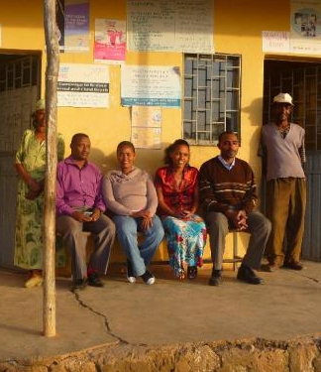
Issue: Insufficient domestic public resources or political will for EPCMD result in funding gaps at all levels of the health system
Issue
Domestic governments have limited resources for EPCMD due to, among other factors:
A limited tax base as a result of widespread poverty and large informal economies
Limited capacity for tax collection and high incidence of corruption and leakage
Competing budget priorities, and a history of donor-funded health programs
Difficulty making the case for EPCMD spending among other health priorities, especially as middle class constituencies grow
Evidence
Over one-third of priority countries do not meet the Abuja target of 15% of general government expenditures going towards health
Health expenditure, public (% of GDP) / Tax revenue, total (% of GDP), 2012*
Below Abuja Declaration target of 15%
Abuja
Declaration
target
PAK
IDN
KEN
IND
MOZ
NPL
BGD
MLI
SEN
UGA
YEM
TZA
GHA
ETH
LBR
AFG
MDG
ZMB
ZAR
RWA
*Figures may seem high because they include on-budget donor funding
Source: World Databank (2013):“Size and Causes of the Informal Sector of the Nigerian Economy;” CSIS (2014): “Paying for Development: Domestic Resource Mobilization;” WHO (2011): “The Abuja Declaration 10 Years On;” Ebere Uneze (2014): “Domestic Resource Mobilization: A Financing Option for Sustainable Development in Africa;” International Business Times (2013) “How many people in India pay income tax? Hardly anyone;” Expert interviews; Dalberg analysis.

Slide 26
Diagnosis: Donor dependence and high OOP spend are common symptoms of insufficient domestic public expenditure
Symptoms
Alternative cause of symptom
Questions to explore alternative causes
Is a financing issue if…
Potential financing issue if…
Decreasing/stagnant national health budget
Contracting overall economy
Is the country’s economy growing?
Yes
National emergencies requiring diversion of funds from health
Has a recent catastrophe influenced government budgeting?
No
High donor dependence for health
Extremely low income/fragile economy with limited capacity for health programming compared to burden
Does the country spend <15% of its budget on health
Yes
High percentage of out-of-pocket spending
Low quality of public sector services or tiered health pricing with out-of-pocket burden falling on the upper-middle classes
Are national policies and programs in place to provide free/subsidized care to the poor?
No
Sub-optimal allocation of funding
Is funding proportionate to the burden of disease and going to the most cost-effective solutions?
Yes
Funding gaps for EPCMD programming
Lack of coordination among donors and governments
Are donor and government priorities aligned?
Yes
Limited capacity in health programs and systems to absorb funding
Does all funding allocated to EPCMD get spent?
Yes
Source: Expert interviews; Dalberg analysis.

Slide 27
Solutions and tools: Taxes, trust funds, and lending can enable solutions to insufficient domestic resources
Solution | Tools | Conditions for application
New government revenue sources | Taxes and levies to increase government resources available for health and EPCMD | Political will exists to improve the tax collection capacity increase and increase health spending Public delivery systems have capacity to absorb more funding
Improved government budget allocation to EPCMD | Trust funds to ring-fence domestic resources for EPCMD | Political will exists to allocate funds specifically to EPCMD Donors are willing to coordinate their funding and contribute to trust funds
Increased government borrowing for health | Lending (e.g. bonds, concessional loans) to domestic governments on a long term basis for investment in health | Political will exists for long-term government investment in health Large donor commitments exist and can be leveraged to enable stability and flexibility in EPCMD spending Donors or governments are willing and able to guarantee bonds
Source: Expert interviews; Dalberg analysis.

Slide 28
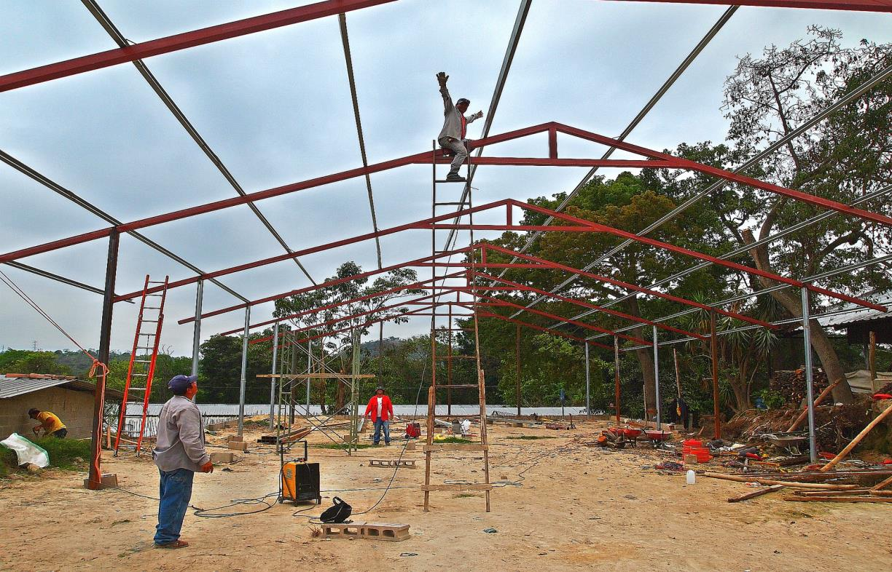


Case study: USAID supported El Salvador on tax reform, mobilizing significant public spending
Before 2004, El Salvador had among the lowest tax revenues in Central America, with rampant tax evasion and limited capacity for collection. It lacked the resources it needed to invest in infrastructure, education, health, and other social services.
USAID partnered with the government of El Salvador in 2004 to reform its tax code, upgrade tax collection capacity, launch new audit systems, and adopt new technologies for tax collection authority.
Tax reform mobilized new domestic revenue sources and enabled increased spending on development, including on health.
These reforms enabled the government of El Salvador to increase its revenues by $350 million per year, enabling the country to double its per capita spending on health, education, and social spending while reducing extreme poverty by 25%.
WHAT IS THE MODEL?
WHAT IS THE IMPACT?
Source: USAID: “Domestic resource mobilization: financing country-led development;” Dalberg analysis. USAID (photo)

Slide 29
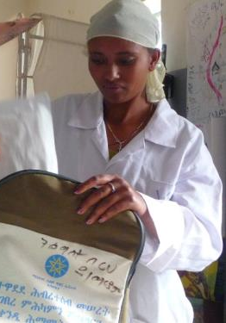
Issue: Lack of provider incentives to provide affordable, quality care to the poor
Issue
Public providers offer heavily subsidized care to the poor, but resource constraints and poor incentive structures limit the quantity and quality of service provided. The difficulty of measuring quality as an output makes it hard--but not impossible—to incentivize quality care
Artificially low prices in the public system limit private providers’ incentives to compete for low-income consumers on the basis of price.
A lack of experimental, venture capital results in little to no innovation in provider business models to serve the poor
Poor consumers’ limited ability to pay and difficulty assessing quality constrains their ability to shape the market by choosing among providers or demanding higher quality services
As a result, poor consumers lack viable options for affordable, high quality healthcare. At public and private facilities, they encounter poor management, long wait times, absent or overburdened health workers, and rushed service
Evidence
Despite subsidized public care, many customers, including the poor, choose private providers…
…but private providers often don’t provide higher-quality care
Population receiving care from private, for-profit providers in select priority countries (%)
Health facility performance in MCH complications (Kenya/Uganda, %)
Lowest income quintile
Public
Highest income quintile
Private
NGA
UGA
KEN
ETH
KEN
UGA
Source: IFC (2008): “The Business of Health in Africa;” World Bank: “Service Delivery Indicator Data;” WHO (2001): “Working with private sector providers for better healthcare;” USAID (photo); Expert interviews; Dalberg analysis.

Slide 30
Diagnosis: Low private sector growth and low quality care are common symptoms of limited incentives
Symptoms
Alternative cause of symptom
Questions to explore alternative causes
Is a financing issue if…
Potential financing issue if…
Limited growth in the private health sector
Strong public delivery systems
Do consumers primarily seek care from public providers?
No
Limited bank lending or venture capital to the private health sector
Is lack of access to capital the primary constraint to growth?
No
Low quality care in public and private facilities
Insufficient overall funding for EPCMD
Do facilities have sustainable business models?
Yes
Insufficient training for health workers
Are health workers properly trained on EPCMD interventions?
Yes
Long wait times
Lack of health workers
Does the ratio of providers/patients correlate with wait times?
No
Is poor management a key driver of symptoms?
No
Frequent stock-outs of essential commodities
Working capital gaps
Do health providers have efficient and effective systems for procurement?
Yes
Source: Expert interviews; Dalberg analysis.

Slide 31
Solutions and tools: PPPs, P4P, and DIBs can enable solutions that improve provider incentives
Solution | Tools | Conditions for application
Increased private investment to scale market-based solutions | Investment funds to invest in successful private business models to enable them to scale | Innovative, financially viable private delivery models to serve the poor exist but lack the capital they need to scale Investors are willing to accept the risk/return profile of these models
Increased resources for healthcare | Pay for performance mechanisms on the demand side (e.g. vouchers, CCTs) that empower consumers to help shape the market by choosing between providers | Consumers have the knowledge necessary to make informed decisions about provision The marketplace is competitive: consumers have access to multiple providers
Greater incorporation of private provision into public health schemes | Public private partnerships to bring private delivery models into the public health system, improving efficiency | Poor management in public systems constrains efficiency and quality Private providers exist that have the capabilities to run components of the public delivery system at low-enough cost The government has sufficient resources to contract out and/or private sector players have vested financial interest
New outcome-based incentive structures | Pay for performance mechanisms on the supply side that catalyze innovation in delivery models by linking incentives to outcomes rather than inputs | Political will exists to incorporate P4P incentive structures Measurable outcomes and strong metrics and evaluation systems (M&E) exist Funders structure incentives to strengthen the overall health system, not just for one vertical (e.g., family planning)
 | Development impact bonds to catalyze innovation and improve efficiency in delivery | Measurable outcomes and strong M&E systems exist Investors, donors, governments, providers, and intermediaries are all willing and able to coordinate Investors are willing to commit to a longer time horizon
Source: Expert interviews; Dalberg analysis.

Slide 32
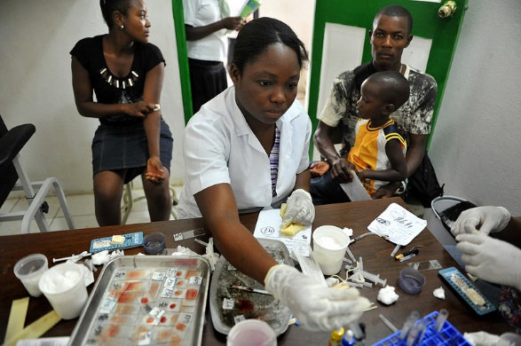

Case study: Rwanda’s performance-based financing program with USAID is used as a model globally
In 2000, Rwanda’s health system suffered from poor quality of care, maternal and infant mortality rates among the highest in the world, and low utilization of health services even when available. The health sector as a whole was both demoralized and severely understaffed.
Performance-based financing was one of three key prongs to a health sector reform strategy, alongside community-based health insurance to address ability to pay, and quality assurance to monitor the PBF program.
USAID, through PEPFAR funding, contracted Management Sciences for Health (MSH) to support the Ministry of Health with health sector reform. MSH worked with the MOH to develop and roll out PBF models nationally for HIV and primary care, including evaluation tools and a web-enabled information system for tracking.
From 2005-2007, the program saw an increase in percentage of births attended by skilled health personnel from 31% to 52%, and a reduction in childhood mortality from 152 to 103 per 1,000 live births. All health centers in Rwanda are now under PBF.
WHAT IS THE MODEL?
WHAT IS THE IMPACT?
Source: USAID (2009): “A Vision for Health: Performance-Based Financing in Rwanda;” USAID (photo); Dalberg analysis.

Slide 33
Issue: Working capital gaps across the value chain limit the quality and quantity of healthcare provided
Issue
Across the commodities value chain, healthcare providers’ revenue streams often misalign with operating expenses. Distributors, providers, and dispensaries must hold large inventories, but customers (individuals, insurance companies, government ministries, donors) often cannot pay up front.
At the same time, providers lack access to the credit to bridge their working capital needs. Banks’ limited knowledge of the health sector and providers’ lack of formality and financial management skills prevent providers from accessing loans
Without access to working capital, providers cannot hold inventories, buy in efficient volumes, and health worker payments may be contingent on accounts receivable. Working capital gaps thus lead to stock-outs, delayed health worker payments, higher costs, and lower quality commodities and services
Working capital gaps are most common in private facilities, as many public providers receive in-kind support (commodities, labor), not cash
Evidence
Use of loans secured by private health providers in Nigeria
Lack of working capital among private health providers increases the need for credit to bridge the gap. In Nigeria, the majority of loans secured by private health providers were used to purchase commodities.*
* Percentages add up to over 100 in some cases because the question allowed for multiple responses
Source: USAID (2009): “Financing and Business Development Needs of Private Health Care Providers in Nigeria”; Expert interviews; Dalberg analysis.

Slide 34
Diagnosis: Some stock-outs and delayed health worker payments in the private sector are symptoms of working capital gaps
Symptoms
Alternative cause of symptom
Questions to explore alternative causes
Is a financing issue if…
Potential financing issue if…
Stock-outs
Broken supply chains
Poor forecasting
Is sufficient capital available to purchase commodities up front at each level of the value chain?
No
Inefficient procurement
Insufficient funding for commodities
Are sufficient funds earmarked for commodities?
Yes
Delayed health worker payments
Insufficient funding for health worker salaries
Are sufficient funds earmarked for health worker salaries?
Yes
Payment logistics challenges
Are there efficient systems for transmitting payments to workers?
Yes
Source: Expert interviews; Dalberg analysis.

Slide 35
Solutions and tools: Increased private lending to the health sector can be enabled through guarantees
Solution | Tools | Conditions for application
Increased private lending to the health sector | Guarantees to local banks can encourage increased lending to private or sub-national health providers, dispensaries, or distributors (often paired with technical assistance to borrowers and lenders) | A strong domestic private financial sector that is willing to consider health sector lending A private (or sub-national) healthcare delivery system with financially viable business models that can or does provide products and services to the poor
Source: Expert interviews; Dalberg analysis.

Slide 36

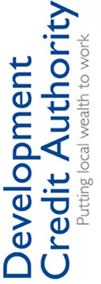
Case study: A USAID DCA in Nigeria helped a major Nigerian bank start lending to healthcare providers
Private healthcare companies in Nigeria are capital-constrained. This is a barrier to:
Serving patients or customers, who often don’t pay up front
Holding inventory, which requires capital to be locked up for months, and
Investing in their facilities, which may require borrowing against future revenues
This capital constraint reduces the quantity of patients they serve and the quality of that service.
USAID guarantees loan portfolios to encourage Diamond Bank and ACCION Microfinance to begin lending in health sector
SHOPS, funded by USAID, provides TA to banks to build their health sector portfolios, and to borrowers (e.g. clinics, pharmacies, midwives) to help make the business case to banks for loans and manage debt. SHOPS also facilitated linkages between banks and private healthcare providers.
Borrowers can place larger orders to hold inventory, for example
After 12 months, 80% of borrowers were able to serve more patients because of the capital they had been able to access.
Although utilization rates on the guarantee were relatively low, the banks involved became leaders in the health lending space, and have built large, unguaranteed health lending practices.
USAID has structured similar deals with banks in the health care sector in other countries, including Ethiopia and Kenya.
WHAT IS THE MODEL?
WHAT IS THE IMPACT?
Source: USAID (2014): “Global Health DCA Primer;” SHOPS: “Nigeria;” US Army Africa (photo); Expert interviews; Dalberg analysis.

Slide 37
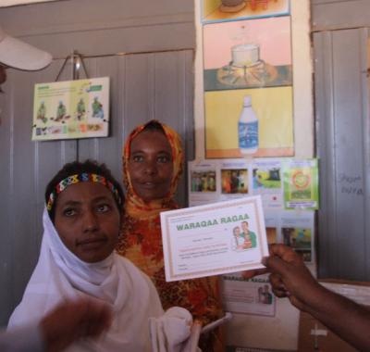

Issue: Delayed and incomplete health worker salaries limit incentives to provide quality care
Issue
Even when sufficient funding has been budgeted for health worker salaries, salaries may not reach them on time or in full due to inefficiencies in payment delivery systems, logistics management or lack of available funds
Payments may pass through several intermediaries before reaching workers, resulting in long processing times and increasing the chance of leakage and corruption, particularly when salaries are paid in cash
Logistical difficulties also impede efficient delivery: especially in rural areas, payments have to be sent over long distances to reach health workers
Delayed and incomplete salaries limit health worker incentives to provide quality care, resulting in absenteeism, strikes, and informal payments from consumers to subsist in the face of incomplete or late salaries
Evidence
Absenteeism among health workers is common
Health worker absence rates in public clinics in select priority countries (% absent at time of spot check)
BGD
IND
IDN
UGA
Source Chaudhury et al. (2006): “Missing in action: teacher and health worker absence in developing countries;” World Bank: “Service Delivery Indicators Data;” Kalra (2015): “Payment delays dent India's flagship health, AIDS programmes;” Brac (2015): “Mobile money improves incentive schemes for health workers;” USAID (photos); Expert interviews; Dalberg analysis.

Slide 38
Diagnosis: The key challenge is to distinguish delayed payments from insufficient funding for salaries
Symptoms
Alternative cause of symptom
Questions to explore alternative causes
Is a financing issue if…
Potential financing issue if…
Absenteeism among health workers
Insufficient funding for health worker salaries
Are sufficient funds earmarked for health worker salaries?
Yes
Insufficient incentive structures for health workers
Are health workers absent despite being paid in full and on time?
No
Union-led intervention
Health worker strikes
Insufficient funding for health worker salaries
Are sufficient funds earmarked for health worker salaries?
Yes
Informal payments from consumers
Insufficient funding for health worker salaries
Are sufficient funds earmarked for health worker salaries?
Yes
Corruption
Are health workers receiving informal payments to supplement their salaries, or because they haven’t received them?
No
Lack of transparency
Source: Expert interviews; Dalberg analysis.

Slide 39
Symptoms and tools: Payment systems enable more efficient delivery
Solution | Tools | Conditions for application
New mechanisms to improve payment logistics | Payment systems to improve the efficiency of health worker payments, e.g. through digital currency and mobile money platforms | Sufficient funding exists for health worker payments Strong and trustworthy digital infrastructure and banking systems exist in country Mobile penetration is high
Increased private investment to scale market-based solutions | Investment funds to provide capital to design or scale models for efficient payment delivery | Successful payment delivery system models exist, but lack the investment capital they need to scale
Source: Expert interviews; Dalberg analysis.

Slide 40
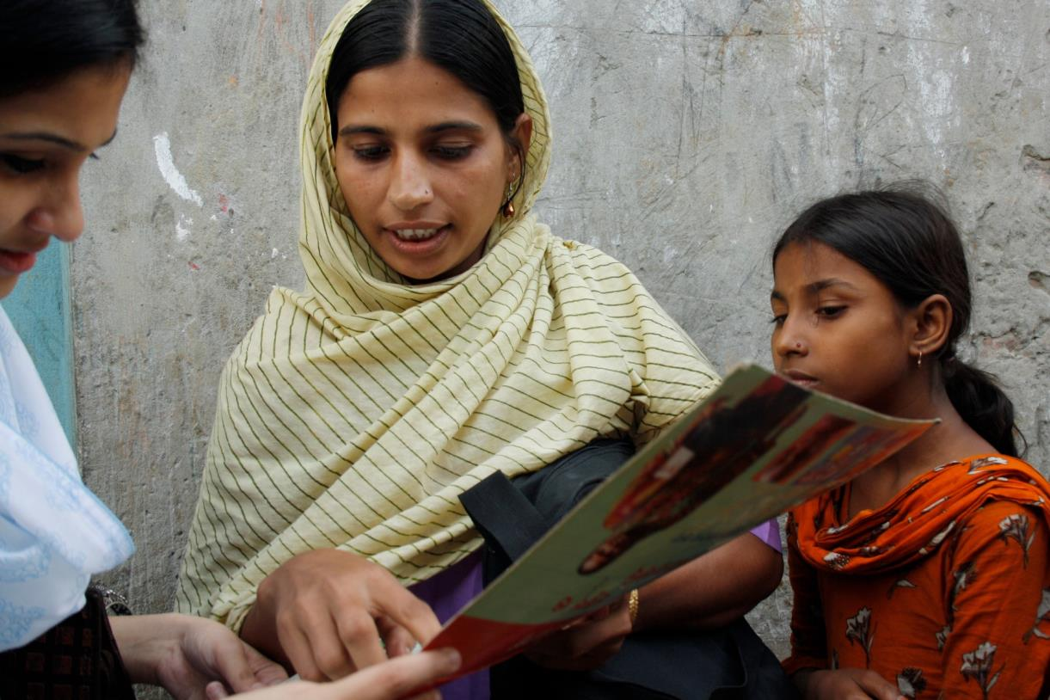

Case study: MAMA and USAID had success using mobile payments for CHWs in Bangladesh
With the support of USAID’s mStar project and FHI 360, MAMA created a strategy to use mobile payments for its CHWs.
1,200 CHWs with BRAC in Bangladesh had a partnership with MAMA, which offers healthcare SMS messages for expecting mothers – for every new subscriber, they received a monetary incentive. However, MAMA incentives took 41 days and 32 person hours to process, and had to be picked up in person, which posed opportunity costs and other deterrents for CHWs .
USAID’s mSTAR project and FHI 360 supported MAMA in building the strategy and providing technical assistance (to both BRAC and the CHWs themselves)
MAMA’s implementing partner Dnet coordinated the process
Mobile payment services like bKash and DBBL were selected as the partner payment platform
Processing time for CHW incentives was reduced from 41 days to 11 days
Using mobile financial services instead of processing the payments in cash saves nearly $6,000 per year and 25.5 workdays per 1,000 CHWs
CHWs report satisfaction with the new system, including feeling safer that they do not have to carry cash back from the district offices
WHAT IS THE MODEL?
WHAT IS THE IMPACT?
Source: BRAC (2015): “Mobile money improves incentive schemes for health workers”; UN (2014): “UN says health workers in Sierra Leone to receive hazard pay using mobile money;” Center for Health Market Innovations (2015): “Lessons Learned from Pathfinder on mobile money payments for CHWs;” DFID/BRAC (photo); Dalberg analysis.

Slide 41

Issue: Limited ability to pay prevents the poor from accessing care, hindering progress in EPCMD
Issue
  High direct costs, indirect costs, and limited incomes prevent women from being able to pay for the EPCMD services they need without enduring financial hardship
  Financial considerations can outweigh perceived benefits of seeking care, limiting mothers’ use of services
  As a result, many mothers do not access healthcare until their conditions have escalated to emergency levels, when interventions are both more expensive and less effective
  High out-of-pocket costs can subject those who do seek care to financial catastrophe, pushing them (further) below the poverty line
  Because consumers, especially the poor, lack resources, providers have few incentives to invest in serving them
Evidence
Ability to pay determines access to critical EPCMD services, as evident in the gap between rich and poor
Skilled attendant births by wealth quintile in USAID priority countries (% of births)¹
BGD
ZAR
ETH
GHA
HTI
IND
IDN
KEN
LBR
MDG
MWI
MLI
MOZ
NPL
NGA
PAK
RWA
SEN
UGA
TZA
YEM
ZMB
Bottom wealth quintile
Top wealth quintile
*Most recent DHS or MICS data available for each country. No data available for South Sudan or Afghanistan.
Source: WHO: “Global Health Observatory Data Repository;” Expert interviews; Dalberg analysis.

Slide 42
Diagnosis: Low utilization, delays in seeking care, and catastrophic expenditures are common symptoms
Symptoms
Alternative cause of symptom
Questions to explore alternative causes
Potential financing issue if…
Low utilization of crucial EPCMD interventions
Unavailability of service providers
Is quality care available and accessible?
Yes
Unreliability of service providers
Are long waits or perceived low quality barriers to patients’ seeking care?
No
Lack of consumer knowledge
Does sufficient demand exist for EPCMD interventions?
Yes
Patients seeking urgent instead of preventative care
Cultural norms
Inaccessibility of service providers
Are outpatient providers in locations that are physically accessible to poor consumers?
Yes
Lack of consumer knowledge
Does sufficient demand exist for EPCMD interventions?
Yes
Catastrophic household expenditures on health
Cultural norms
Lack of innovation in low-cost solutions and business models
Are there opportunities to drive down the cost of products and services through innovation?
No
Source: Expert interviews; Dalberg analysis.

Slide 43
Solutions and tools: Financing instruments can enable national health schemes, vouchers, and microinsurance
Solution | Tools | Conditions for application
New national policies to lower healthcare costs to consumers | Risk pooling mechanisms (i.e. national health insurance schemes) to make health spending more efficient and predictable | Political will and domestic resources exist to create or scale national health insurance schemes Healthcare providers are available, accessible, and reliable
New or expanded health savings, lending, and microinsurance products | Risk pooling mechanisms to make health spending more efficient and predictable through microinsurance schemes | A strong microfinance sector exists and is willing to consider health insurance models An ecosystem of low-cost healthcare providers exists
 | Guarantees to microfinance institutions to facilitate health financial products (e.g. credit, savings, insurance), or to banks to facilitate on-lending to microfinance institutions | A strong domestic financial sector (including banks and MFIs) exists, and is interested in health lending and knowledgeable about the health sector and its borrower classes Lack of access to finance is the primary constraint for MFIs looking to expand into health
 | Investment funds to help scale successful microfinance and microinsurance models for health | Microfinance and microinsurance models for health exist, are financially viable, and can achieve modest returns Lack of access to investment capital for experimentation or scale is a primary constraint for successful microfinance health models
Increased consumer resources for healthcare | Pay for performance mechanisms on the demand side (e.g. vouchers, CCTs) to increase ability to pay and utilization of key services | Healthcare providers are available, accessible, and reliable
Source: Expert interviews; Dalberg analysis.

Slide 44
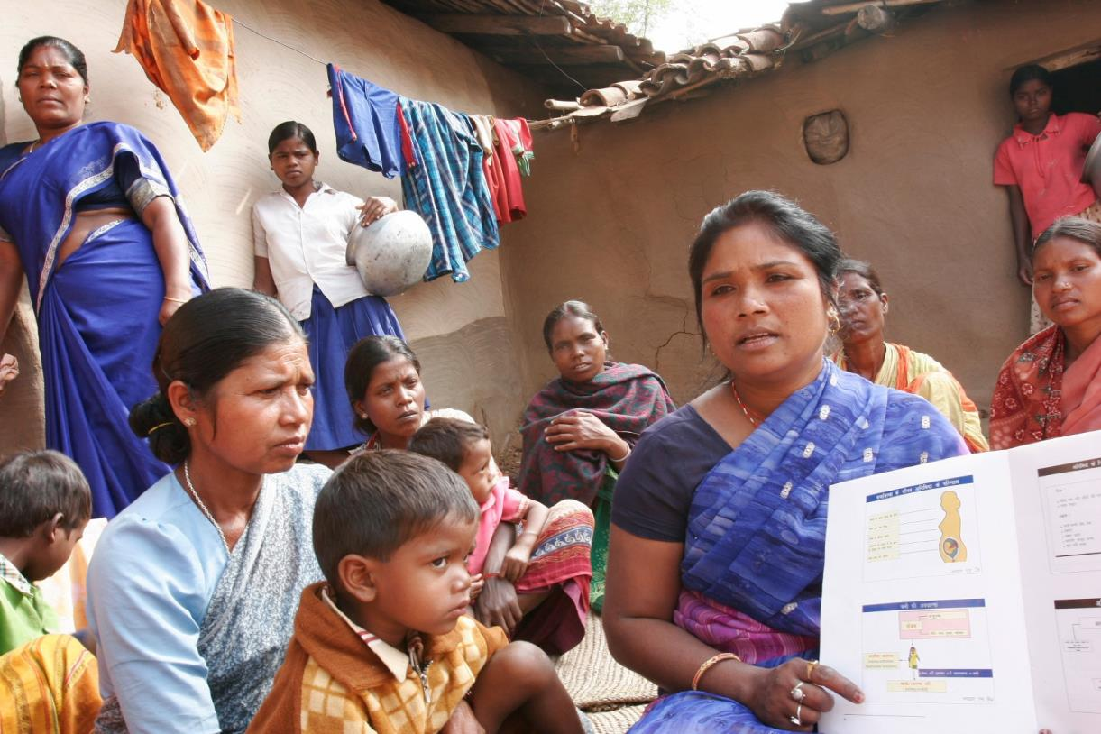

Case study: Demand-side financing vouchers in Bangladesh support access to maternal health services
Limited ability to pay for products, services, and transport prevents Bangladeshi women from accessing the maternal health services they need. Only 12% of women in the poorest quintile give birth with skilled attendants. In 2004, Bangladesh launched demand-side financing vouchers for reproductive health to help overcome financial barriers, incentivize health seeking behaviors, and increase utilization of key EPCMD services such as antenatal care and institutional delivery.
The Ministry of Health and Family Welfare, in partnership with the WHO, offers vouchers to pregnant women for pre/post natal care, delivery (including emergency obstetric care), and transportation
Health providers receive payments for registering and serving voucher recipients
Patients receive free or subsidized maternal health services
Pilot results
% women, before and after pilot
Before pilot
After pilot
WHAT IS THE MODEL?
WHAT IS THE IMPACT?
Facility delivery
Antenatal care
Postnatal care
Source: Hera (2013): “Program Evaluation for Demand Side Financing Maternal Health Voucher Scheme in Bangladesh;” USAID (2010): “Performance Based Incentives Primer;” Population Council (2014): “Evaluating Voucher-and-Accreditation Programs to Improve Maternal and Reproductive Health Service Delivery;” USAID (photo); Dalberg analysis.

Slide 45
Table of contents
Towards Sustainability: An Introduction to the Financing Framework for EPCMD
The Financing Framework
Resources to apply the Financing Framework
Deep dive on symptoms, underlying financing issues and solutions
Tools to enable solutions: when and how they apply
Case study library

Slide 46
In this chapter, we will consider what options are available, within and outside of USAID, to implement each of the tools
For each profiled tool….
…there are three possible pathways for implementation
Guarantees
Lending
Investment funds
Taxes and levies
Public-private partnerships
Pay for performance
Risk pooling mechanisms
Payment systems
Corporate social responsibility
Trust funds
Development impact bonds
USAID structures transactions for some tools themselves, with HQ offering support to missions throughout the process (e.g. guarantees)
Implementing partners or other donors can lead or co-lead the execution of some tools, with missions providing financial support and/or TA (e.g. impact investments, payment systems)
Governments lead execution of some tools, with missions providing thought partnership and TA (e.g. taxes and levies)
Source: Expert interviews; Dalberg analysis.

Slide 47



Guarantees: Missions can support guarantees directly through DCA to mobilize private lending for EPCMD
Overview of tool
Pathways to implementation
How does it work? Guarantees mobilize private sector lending to increase healthcare providers’ access to capital, enabling them to provide more and higher quality health products and services.
USAID’s Development Credit Authority (DCA) can work with missions to structure guarantees.
When can it be used? DCAs work in contexts where loans are withheld because a lender (such as a bank) lacks the information, or risk-willingness. This requires a market with:
A strong domestic private financial sector that is willing to consider health sector lending
A private or sub-national healthcare delivery system with financially viable business models that can or does provide products and services to the poor
What are first steps? The DCA team in Washington can help missions determine whether guarantees are appropriate, and if so, can structure, execute, and monitor transactions
loans
Local banks
repayment
Health borrowers
Increased willingness to lend
Increased access to credit
guarantee
What impact can it have on EPCMD? Guarantees can mobilize private lending to help providers at all levels of the health system access the capital they need to:
Purchase commodities and equipment
Train health workers
Invest in infrastructure
Expand operations and improve quality
If you’re interested in considering the use of a guarantee, read the DCA primer and reach out to the DCA office to learn more
Source: USAID (2014): “Global Health DCA Primer;” Expert interviews; Dalberg analysis.

Slide 48



Lending: In certain countries, the development of a municipal bond market can have a big impact on health
Overview of tool
Pathways to implementation
How does it work? A bond issuer (in this case, a municipality) sells a bond to investors. These can be individuals, often citizens, but can also include other types of private investors depending on how risky it is lending to the government. The government pays the administrative and legal costs of issuing the bonds, but can use the rest to finance public projects such as building a network of hospitals. Investors are paid interest according to a set of pre-agreed terms and conditions.
What impact can it have on EPCMD? Most bonds are “general” rather than sector-specific, but they can help governments increase domestic spending on health (or anything else) without creating a new revenue stream or cutting other spending.
Missions can primarily play a technical assistance role in promoting the use of municipal bonds for health. There are a number of advantages to using municipal bonds to finance critical projects, and many policymakers have become interested in developing and/or strengthening their municipal bond market. Providing TA to develop stronger transparent, and accountable financial management and reporting systems is key to success in bond issuance.
When can it be used? Bonds for health work best when:
Tax revenue as a % of GDP is high. If tax revenue is not sufficient to pay back significant levels of debt, borrowing using bonds may not be the right course of action.
The political environment is relatively stable. Although some are more risk-tolerant than others, investors typically shy away from high-conflict states and volatile economies.
Governments are committed to health goals. Because most municipal bonds are not sector-specific, building municipal bond markets will have the most impact if the government is already meeting its Abuja targets, and you believe that if the budget was higher, this would result in more funding overall for health.
What are first steps? Reach out to DCA to learn more.
Pay upfront for bond
Investors
Government
Pays back with interest
Bonds
Uses borrowed money to
finance critical projects
If you are interested in municipal bonds, contact the DCA office to learn more
Source: USAID (2014): “City of Dakar announces first West African municipal bond;” USAID (1997): “Municipal Bond Market Development;” Leighland, James (1997): “Accelerating municipal bond market development in emerging economies: an assessment of strategies and progress;” Dalberg analysis.

Slide 49

Investment funds: Missions can provide grants, guarantees, or TA to support investment in health
Overview of tool
Pathways to implementation
How does it work? Socially responsible investors provide investment capital (usually equity, but can also be debt) to businesses that generate financial returns as well as social impact. In some cases, this private capital is blended with donor funding or guarantees to mitigate risk, enhance returns, or provide TA to investees.
Missions can provide grants or guarantees to investment funds to catalyze private investment in the health sector.
When can it be used? Investment funds for health are an appropriate model when:
Financially viable private sector business models exist but need investment capital to scale
Socially responsible impact investors are interested in investing in the health sector but may need risk-sharing mechanisms to incentivize investment
What are first steps? Reach out to the Private Capital Group in E3 to think through how to structure USAID involvement.
Private investors
Donors
Investment $
Concessional $
Impact investment fund
TA
Equity
Missions can provide TA through implementing partners to investees, helping them achieve greater financial and social returns.
When can it be used? Where investment funds for health have already been set up, missions can help provide TA to (potential) investees to help them strengthen management and capacity.
What are first steps? Reach out to SHOPS to learn more about TA for investees.
Private healthcare SMEs
What impact can it have on EPCMD? Impact and other investment funds can help grow the private healthcare sector, enabling innovative business models (e.g. clinics, dispensaries, insurance schemes) that serve low-income consumers to reach scale.
If you’re considering supporting investment funds for health, reach out to PCG or SHOPS to learn more
Source: SHOPS (2014); Expert interviews; Dalberg analysis.

Slide 50





Taxes and levies: Missions can help governments improve tax administration and collection, increasing public resources available for EPCMD
Overview of tool
Pathways to implementation
How does it work? Taxes are a source of government revenue, however, weak administration and collection systems, and corruption can limit the amount of revenue raised. Improving this process ensures that additional resources are available for health.
Missions can provide TA and advisory support to governments on improving tax administration and collection.
When can it be used? Where USAID missions have close working relationships with governments, and where political will exists to address corruption, tax evasion and collection issues, USAID can provide TA to governments to improve collection capacity, infrastructure, effectiveness, and transparency.
What are first steps? USAID’s Office of Health Systems is collaborating with the Office of Economic Policy in the Bureau of Economic Growth, Education, and Environment (E3/EP) and can provide expertise and analysis to support missions’ work with governments on taxes.
Populations
Government tax
Industries
Increased domestic resources
Goods
What impact can it have on EPCMD? Improved taxes administration and collection can increase the amount of government resources available for health, which can enable:
Reduced dependence on donors for health funding
Improvements to the overall public health delivery system
Funding for commodity procurement
Financing for national health insurance schemes
If you’re considering improving tax administration, reach out to the Office of Health Systems to learn more
Source: USAID: “Domestic resource mobilization: financing country-led development;” USAID Office of Economic Policy (2015); Expert interviews; Dalberg analysis.

Slide 51
PPPs: Missions can support the government and the private sector to structure partnerships
Overview of tool
Pathways to implementation
How does it work? PPPs allow the private sector to play a role in delivering a government service, using a combination of public and private capital. They work by turning service provision into an opportunity to earn a profit—but may still deliver a lower cost or higher quality service than a non-profit or state agency. Success of PPPs depends on how incentives and outcomes are structured.
At the national level, most PPP opportunities for EPCMD are in:
  Service delivery and facility management: providing public services on behalf of the government
  Logistics and distribution: PPPs have been and are used to support the distribution of commodities, both by private and non-profit actors
What PPPs are not: PPPs are not privatizations--ministries are still accountable for service quality—and they are not service delivery contracts—the partnership is longer term and often incorporates private capital.
What impact can it have on EPCMD: PPPs can impact EPCMD in two ways: first, if the private sector can deliver a service more effectively. Second, they often bring additional private capital into play.
Missions are uniquely positioned to begin a dialogue between the government and private sector and help structure an agreement. Successful PPPs are attractive to both the state and the private sector, but identifying a workable opportunity can be difficult. Missions can identify high potential opportunities for impactful PPPs and bring in expert support in structuring, which is a key driver of success.
When can it be used? PPPs work best when:
There is a qualified private sector actor with a low cost basis who can deliver a similar quantity of service at a similar cost with higher quality
Improved management of a critical segment of the health infrastructure commodity logistics improves efforts across the network
Outcomes can be measured without creating perverse incentives
There is a genuine service gap or systematic need, not a short term challenge (e.g. H1N1 outbreak)
What are first steps? Reach out to the Global Health Bureau’s Center for Accelerating Innovation and Impact (CII) to learn more.
If you are interested in PPPs, contact CII to learn more about how USAID has supported this work in the past. The SHOPS program also produced a useful primer on PPPs in health
Source: Barnes (2011): “Designing Public-Private Partnerships in Health;” Expert interviews; Dalberg analysis.

Slide 52


Pay for performance: Missions can implement P4P programs directly or by supporting partners or governments
Overview of tool
Pathways to implementation
How does it work? Pay for performance mechanisms link financial or other incentives to pre-agreed and measurable outcomes or performance targets to catalyze improvements in the achievement of those outcomes.
Missions can implement P4P by funding pilots or incorporating incentives into existing programming.
When can it be used? Missions that have prior experience with P4P, or that have significant time and resources to dedicate to structuring mechanisms, may want to consider direct implementation.
What are first steps? Missions can consult internally or regionally on past experiences with P4P, or reach out to the Office of Health Systems for help determining the best path forward
Increased demand and ability to pay
P4P
Incentives to provide quality care
Incentives to improve quality and efficiency of provision
Missions can provide grants, TA, and advisory support to implementing partners, other donors or governments to start or scale P4P programs.
When can it be used? In countries where P4P pilots are underway, missions can support program improvements and scale up. Where P4P efforts are more nascent, mission can convene governments, implementing partners and other donors to advise on and support incorporating incentive structures into private and public provision.
What are first steps? Identify existing P4P efforts underway in country and reach out to learn more
What impact can it have on EPCMD? Funders (donors, governments, private investors) can implement P4P mechanisms to increase accountability and improve outcomes at any level of the health system, including:
Increased utilization of EPCMD products and services
Improved health workforce effectiveness
Better quality of care and health outcomes
More innovative, efficient supply chains/delivery systems
If you’re interested in considering the use of a P4P mechanisms, read the performance based incentives primer and reach out to the Office of Health Systems to learn more
Source: USAID (2010): “Performance Based Incentives Primer;” Expert interviews; Dalberg analysis..

Slide 53

Risk pooling mechanisms: Missions can support governments and MFIs to promote health insurance models
Overview of tool
Pathways to implementation
How does it work? National, sub-national, private, micro, and employee sponsored insurance schemes pool risk to make health costs more predictable, reduce of out-of-pocket spending, spread financial risk, and improve access to care
Missions can provide TA and advisory support to governments to create health insurance models
When can it be used? In countries where governments are considering implementing health insurance schemes, USAID missions can provide TA and advisory support to structure models.
What are first steps? Reach out to the Office of Health Systems to learn more about supporting the development of health insurances schemes
Premiums
Coverage
Pooled consumers
Insurance providers
Reduced OOP spend
Payments
Missions can provide grants to and/or convene implementing partners to create and scale microinsurance models.
When can it be used? Missions can best support microinsurance in countries where:
High-potential microinsurance models funding to scale, or
Microfinance institutions are willing to consider health lending but need TA, access to capital, and appropriate partners
What are first steps? Research microfinance institutions to see whether any are involved in the micro-health insurance space
Healthcare providers
What impact can it have on EPCMD? By improving efficiencies in spending on healthcare, risk pooling mechanisms can:
Make health costs more predictable, increasing ability to pay
Enable health spending at times when family savings are low
Increase demand for health products and services
Increase utilization of EPCMD interventions thereby improving health outcomes
If you’re considering supporting risk pooling mechanisms, reach out to the Office of Health Systems to learn more
Source: Expert interviews; Dalberg analysis.

Slide 54



Payment systems: Missions can support digital payment systems with grants and TA
Overview of tool
Pathways to implementation
How does it work? Payment infrastructure (e.g. mobile money) helps smooth logistical difficulties, cut out intermediaries, and enhance transparency to ensure that health workers receive salaries on time and in full.
Missions can provide grants and TA to implementing partners to support the creation and scaling of payment infrastructure.
When can it be used? Payment infrastructure works best when:
Sufficient funding for salaries exists, but logistical difficulties, transaction costs and/or corruption prevent health workers from receiving them on time and in full
Digital infrastructure and banking systems exist in country and can support digital payment platforms, and mobile penetration is high
Partner organizations (e.g. telecoms and relevant government ministries) are willing to support payment infrastructure for health
What are first steps? Reach out to the Digital Development team within the U.S. Global Development Lab to learn more about mobile solutions for payment infrastructure and what it would take to adopt/scale mobile payment platforms.
Intermediaries
Leakage and corruption
Payment infrastructure
Logistical challenges
What impact can it have on EPCMD? By helping salaries reach workers quickly and completely, payment infrastructure can:
Reduce health worker absenteeism and strikes
Improve the quality of care by improving incentives
Reduce the incidence of informal out-of-pocket payments
If you’re considering supporting payment infrastructure, reach out to the Digital Development Team to learn more
Source: FHI360 (2015): “Mobile Solutions Technical Assistance and Research;” Expert interviews; Dalberg analysis.

Slide 55
Corporate social responsibility: Missions can play a key convening role in promoting CSR programs
Overview of tool
Pathways to implementation
How does it work? Corporate social responsibility (CSR) is a wide-ranging set of activities in which companies integrate both social and environmental concerns into their operations. Traditional CSR is most appropriate at addressing specific market failures or helping to catalyze and de-risk private sector investment. Examples of CSR activities in health include:
Grants or other funding to the communities in which the company manufactures or sells its product
Drug donation programs for neglected and tropical diseases (e.g. Pfizer-supported Trachoma Initiative)
Unlike a PPP, CSR generally does not result in immediate financial benefits, but rather bolsters a company’s reputation.
What impact can it have on EPCMD? If a CSR initiative is structured appropriately, it can:
Crowd domestic philanthropic funding towards last mile health delivery, especially where it would be difficult to engage the private sector with market or profit-based incentives
Ensure patients have access to the treatments they need, especially those that might be otherwise unavailable or inaccessible to poor and marginalized groups
Missions can be especially effective in the CSR space by leveraging USAID’s convening power. USAID can bring together corporations interested in CSR and key stakeholders within health.
When can it be used? From a sustainable finance perspective, CSR has highest potential if:
There is a pre-existing CSR law: Countries like South Africa and, more recently, India, have laws that require companies of a certain size to donate some percent of their profits to charitable causes.
There is a thriving domestic private sector: To mobilize domestic resources, there should be a base of large companies that are sufficiently affluent to consider investing in CSR.
Consumer bases are growing: Corporations are often incentivized to conduct CSR in regions in which they would like to expand.
What are first steps? The Global Partnerships Team within the U.S. Global Development Lab coordinates USAID’s activities with multinational corporations, and can also help missions think through CSR partnerships with local companies – this is the first place to reach out if you are considering supporting CSR.
If you’re considering supporting CSR, contact the Global Partnerships Team to coordinate and learn more
Source: Expert interviews; Dalberg analysis.

Slide 56

Trust funds: Missions can provide TA or grants to help structure and grow country trust funds
Overview of tool
Pathways to implementation
How does it work? Country trust funds ring-fence domestic government and donor funding to facilitate long-term investment in a particular health issue.
Missions can provide TA and advisory support to governments to help them structure country trust funds.
When can it be used? In countries where there is political momentum around EPCMD (or a related health issue, e.g. national health insurance), and where missions have close relationships with ministries, missions can help governments set up trust funds.
What are first steps? Reach out to the Office of Health Systems to learn about how and where trust funds have been applied to support sustainable and predictable financing for health.
Domestic budget
Donor resources
Trust fund
Missions can contribute to existing trust funds with grants through implementing partners.
When can it be used? Where country trust funds exist, missions can align their funding through grants.
What are first steps? Reach out government counterparts or partners and other donors to learn more about exiting or potential trust funds that USAID can contribute to.
EPCMD programming
What impact can it have on EPCMD? Trust funds can increase overall funding for EPCMD programming by:
Mobilizing domestic and international resources
Increasing coordination and aligning priorities
Optimizing long-term budget allocation
If you’re considering supporting country trust funds, reach out to the Office of Health Systems to learn more
Source: World Bank (2014): “GFF Concept Note;” SHARE (2013): “Tanzania: government urged to set up health trust fund;” Expert interviews; Dalberg analysis.

Slide 57
Development impact bonds: Missions can support HQ to identify opportunities for and structure DIBs
Overview of tool
Pathways to implementation
How does it work? Development Impact Bonds help incorporate and incentivize the most effective public or private solutions to a challenge that donors or development agencies would otherwise address. In the simplest case, a measurable metric that corresponds to the outcome sought is identified and a partner proposes to hit targets on an agreed to timeframe against those goals. Using a Development Impact Bond, the implementing partner sources private capital to finance their program implementation, and if they achieve their targets they are paid by donors who would have otherwise funded a traditional grant funded intervention, and the implementers can in turn repay their bondholders who financed their work. There are many variants on this structure.
What impact can it have on EPCMD: Many EPCMD objectives could be documented by specific targets that respond to successful interventions. In those cases, development impact bonds can allow donors to use more diverse partners as implementers while minimizing the financial (if not outcome) risk of failure, leverage private capital, and use the investor marketplace to assess effectiveness.
At present, there is limited experience using DIBs in health, however, it is a tool with the potential to incentivize improved health outcomes, create efficiency gains in service delivery, and provide a new vehicle for private sector investment in countries.
When can it be used? DIBs work best when:
There is a clear metric that corresponds to impact (or outcomes) and is directly affected by effective programming. Measurement is a difficult challenge in many environments today, but a proliferation of information technology is changing this.
A DIB can be structured around programming that would otherwise be funded by a donor.
Outcomes can be measured without creating perverse incentives: in many EPCMD applications, outcomes (i.e. # of IUDs implanted), risks creating a perverse incentive for providers
What are first steps? Reach out to the CII team to learn more.
If you are interested in DIBs, contact CII to learn more about them
Source: Expert interviews; Dalberg analysis.

Slide 58
Contacts: Reach out to these resources to learn more about supporting financing tools
Tool | USAID Resource Contact Information
Guarantees | developmentcredit@usaid.gov
Lending | developmentcredit@usaid.gov
Investment funds | sustainablefinancing.gh@usaid.gov
Taxes and levies | sustainablefinancing.gh@usaid.gov
Public-private partnerships | cii@usaid.gov
Pay for performance | sustainablefinancing.gh@usaid.gov
Risk pooling mechanisms | sustainablefinancing.gh@usaid.gov
Payment systems | sustainablefinancing.gh@usaid.gov
Corporate social responsibility | sustainablefinancing.gh@usaid.gov
Trust funds | sustainablefinancing.gh@usaid.gov
Development impact bonds | cii@usaid.gov

Slide 59
Table of contents
Towards Sustainability: An Introduction to the Financing Framework for EPCMD
The Financing Framework
Resources to apply the Financing Framework
Deep dive on symptoms, underlying financing issues and solutions
Tools to enable solutions: when and how they apply
Case study library

Slide 60
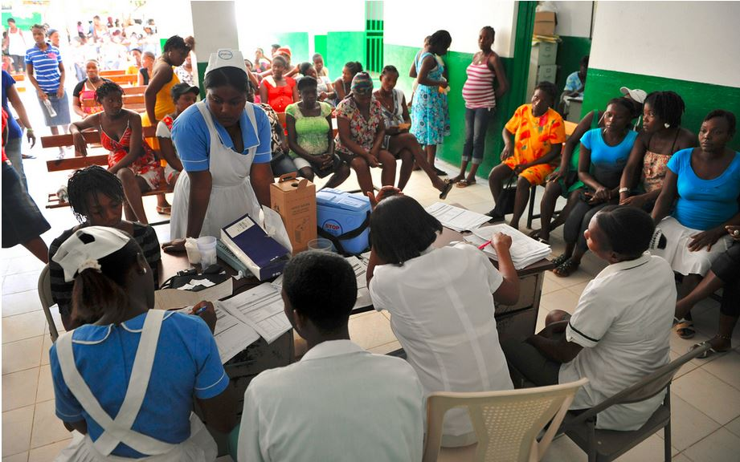
Case study: The Global Financing Facility will be a pathfinder mechanism for development finance in the post-2105 agenda
The Global Financing Facility for Every Woman Every Child aims to accelerate efforts to end preventable maternal, newborn, child and adolescent deaths. The GFF brings partners together to provide:
Smart financing to ensure that evidence based, high impact interventions are prioritized
Scaled financing, mobilizing the additional resources necessary to finance the full RMNCAH agenda from both domestic and international resources
Sustainable financing to main increased RMNCAH results
The GFF will operate as a facility that maximizes the comparative advantage of a broad set of partners to accelerate efforts to end preventable deaths. A number of approaches and mechanisms are used to do this, including:
Investment Cases for RMNCAH
Mobilization of financing for Investment Cases
Medium-term health financing strategies focused on sustainability
Investments in global public goods that support RMNCAH results at the country level
The GFF is not a financing tool, but rather a financing facility for a variety of sustainable financing tools, approaches, and activities
The Financing Framework complements the GFF by encouraging missions to think through near-term and medium-term sustainable financing activities that fit into the GFF’s broader architecture
WHAT IS THE MODEL?
WHERE DOES IT FIT IN?
Source: World Bank (2014): “GFF Concept Note;” USAID (2015): “GFF Brown Bag Lunch;” USAID (photo); Dalberg analysis.

Slide 61

Case study: The City of Dakar, with the support of DCA, announced the first municipal bond in West Africa
In 2014, the City of Dakar announced a $41.8 million bond to raise funds for the construction of a marketplace for more than 3,500 street vendors.
The bond will be backed by a DCA bond guarantee, and supported with technical assistance from the Gates Foundation.
Beyond raising the capital needed to construct the vendor marketplace, this transaction is expected to attract new financing partners to the region, including pension funds and insurance companies. Because this will be the first municipal bond in West Africa, it has the potential to set a precedent for diversifying and increasing capital resources for critical infrastructure, including in health, in emerging markets.
WHAT IS THE MODEL?
WHAT IS THE IMPACT?
Source: USAID (2014): “Supported by USAID guarantee, city of Dakar announces first West African municipal bond at USAID Frontiers in Development;” Dalberg analysis.

Slide 62


Case study: The Solidarity Levy on Airline tickets mobilizes funds for health through a small tax
The airline solidarity levy was designed as a way to provide dedicated, predictable funding flows to UNITAID; by placing a modest tax on airline tickets, countries are able to ensure that they are only collecting the tax from people likely to be able to afford it. UNITAID is a drug purchasing facility that negotiates global price reductions on pharmaceutical drugs, which all public health organizations are able to benefit from; emphasis is placed on diseases for which the poor shoulder the highest burden (e.g. tuberculosis, malaria and HIV).
Participating countries, which include Cameroon, Congo, Madagascar, Mali, and Niger, determine the rate at which they will tax airline tickets
Consumers purchasing tickets in that country (whether foreigners or domestic nationals) automatically pay the tax
UNITAID uses the funds; the predictable funding flows help it to incentivize manufacturers to product quality medical products at affordable prices
9 countries have signed on as participating partners
The levy has raised 65% of UNITAID’s funds (more than USD 1.9B)
It has had no negative effect on revenue and profitability, air traffic, travel industry jobs and tourism. Also, the levy is implemented by existing national authorities so the setup costs have been low
WHAT IS THE MODEL?
WHAT IS THE IMPACT?
Source: Dalberg (2014): “Innovative Financing Database;” UNITAID (2012): “UN World Economic and Social Survey discusses UNITAID’s unique model;” EconoMonitor (2014): “Financing Development: Are International Solidarity Levies the Answer?;” Flickr user m01229 (photo); Dalberg analysis.

Slide 63

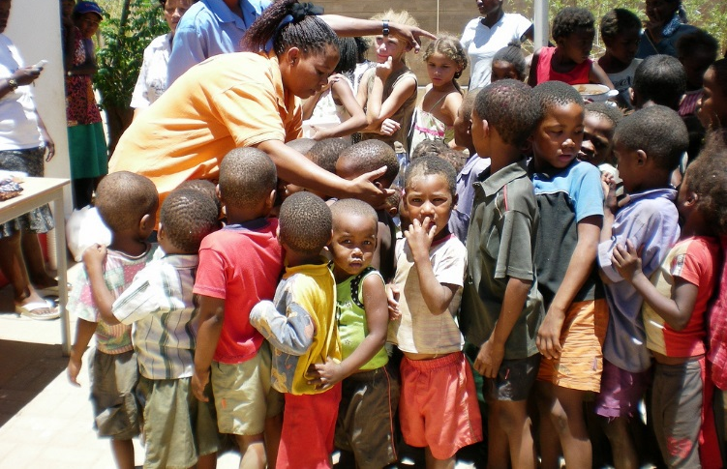
Case study: PRODUCT(RED) mobilizes private resources through donations in customer purchase
Despite proven interventions to prevent and treat HIV/AIDS, 22 million HIV-positive individuals lack access to lifesaving treatment. The bulk of HIV/AIDS occurs in the poorest countries.
PRODUCT(RED), founded in 2006 by Bono and Bobby Shriver, provides a platform for corporations to engage in CSR for HIV/AIDS. Its success depends on high-profile corporate partners, which currently include Gap, Apple, and Beats by Dre.
Licensed partners create (RED)-branded products, and donate up to 50% of profits on these products to the Global Fund (percentage set by the company). The business model was designed to increase consumer purchases for the company, while simultaneously resulting in increased donations and awareness.
PRODUCT(RED) has donated over $300M to the Global Fund, making it the largest donor; funds have been dispersed across Africa.
While PRODUCT(RED) mobilizes global resources from high-income countries through CSR, it can serve as a model for CSR campaigns among corporations in developing countries.
WHAT IS THE MODEL?
WHAT IS THE IMPACT?
Source: Dalberg (2014): “Innovative Financing for Development;” Nora Hanagan: “Product(RED);” Dalberg analysis.

Slide 64


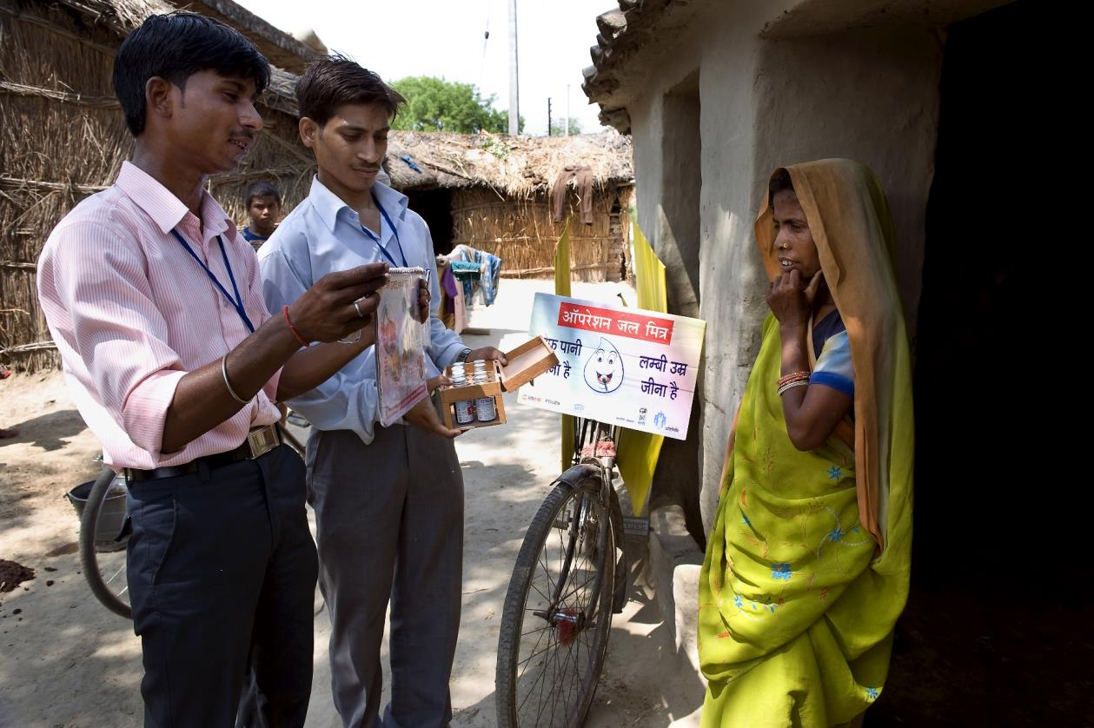

Case study: Karuna Trust uses PPPs to leverage private sector resources within the health system in India
In India, over 30% of people living in rural areas and 20% in urban areas do not seek care. Every year, nearly 39 million people are pushed into poverty due to financial catastrophe caused by poor health and health emergencies, and out-of-pocket spending remains high at 72% of expenditure on drugs.
Launched in 1986, Karuna Trust is a public charitable trust in India that leverages public-private partnerships to support the Government of India’s goal to deliver quality health care to the last mile.
Karuna Trust takes over management of poor-performing Primary Health Care Centers (PHCs) and, using a combination of PPPs and CSR, engages the private sector to rehabilitate these centers and transform them into models of care.
The Trust currently manages 68 PHCs in 8 states – Karnataka, Andhra Pradesh, Orissa, Arunachal Pradesh, Manipur, Maharashtra, Meghalaya, and Rajasthan; total staff at these centers tops 1,000, reaching over 1 million people.
WHAT IS THE MODEL?
WHAT IS THE IMPACT?
Source: Karuna Trust (2015); Center for Health Market Innovations (2015):“Karuna Trust;” Dalberg analysis.

Slide 65
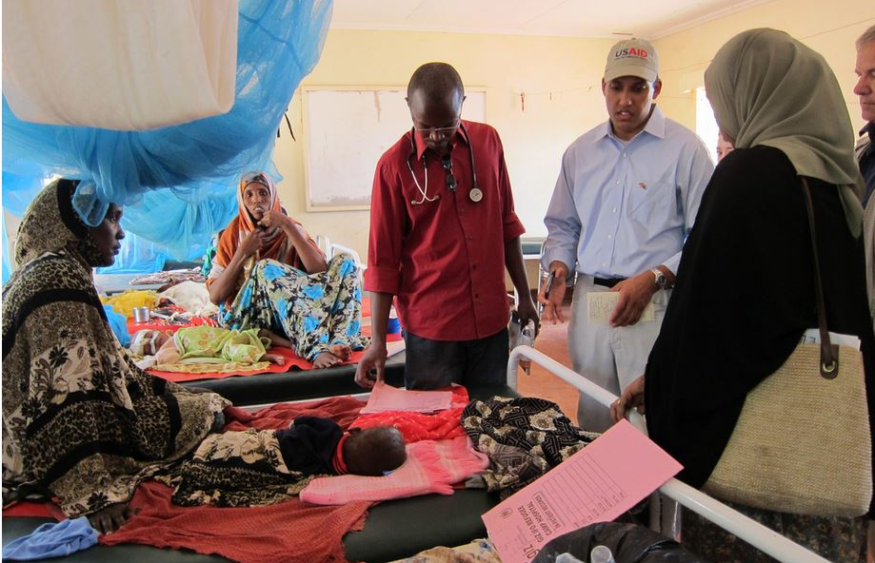

Case study: Kenya incorporated private providers into the public health insurance scheme
Kenya administers a compulsory national health insurance scheme (NHIF) for all formal-sector employees, and until 2012 relied on public healthcare providers.
Despite paying for coverage, those who could afford it turned to private insurance schemes or paid out-of-pocket at private facilities. Those who couldn’t afford private care encountered low quality and long wait times in public facilities.
Kenya is one of several countries experimenting with ways to incorporate private provision into publicly financed schemes to improve quality and equity, especially for the poor.
Kenya partnered with established private providers to improve NHIF’s service quality through a tender process to pilot private outpatient care.
Multiple, pre-approved outpatient clinic networks agreed to capitation model based fees for NHIF members, pre-paying on per head visits.
The policy increased quality and satisfaction with the system, but larger impacts are not yet felt. Because the pilots were small in scale and focused on outpatient care, little improvement maternal or child health outcomes is expected.
Capitation models have promise as cost-effective private sector partnership models for public and private insurers, but integrating private providers will not necessarily improve quality of public delivery system, and relying on private providers may raise costs overall.
WHAT IS THE MODEL?
WHAT IS THE IMPACT?
Source: Witter et. al (2009): “Providing free maternal health care: ten lessons from an evaluation of the national delivery exemption policy in Ghana;” USAID (photo); Dalberg analysis.

Slide 66





Case study: Children’s Investment Fund Foundation, Instiglio, UBS, and Educate Girls launched the first development impact bond in India
A pilot development impact bond was launched in Rajasthan, India, to help address high drop out rates and poor education quality. In Rajasthan,
40% of girls leave school before 5th grade and only 15% of primary school children can read a simple story in Hindi.
The UBS Optimus Foundation raised initial funding from investors. With this funding, Educate Girls, an NGO, will implement programs to improve educational outcomes. Instiglio, a non-profit intermediary, manages the project and CIFF, the outcome payer, will pay returns to investors if pre-determined outcomes are achieved.
The DIB was launched in June 2014, and service delivery will begin in June 2015, so results of the pilot have not yet been demonstrated. The project aims to retain 10,000 girls and improve basic Hindi, English, and math skills for 20,000 students in 150 poor performing schools. If Educate Girls achieves these outcomes, CIFF will pay back investors with 7-13% returns.
Pilot development impact bonds in health, which use a similar model to improve healthcare through outcomes-based incentive structures, are currently under development by other donors.
WHAT IS THE MODEL?
WHAT IS THE IMPACT?
Source: CGDev (2014): “First Development Impact Bond is Launched;” Pasand (photo); Dalberg analysis.

Slide 67

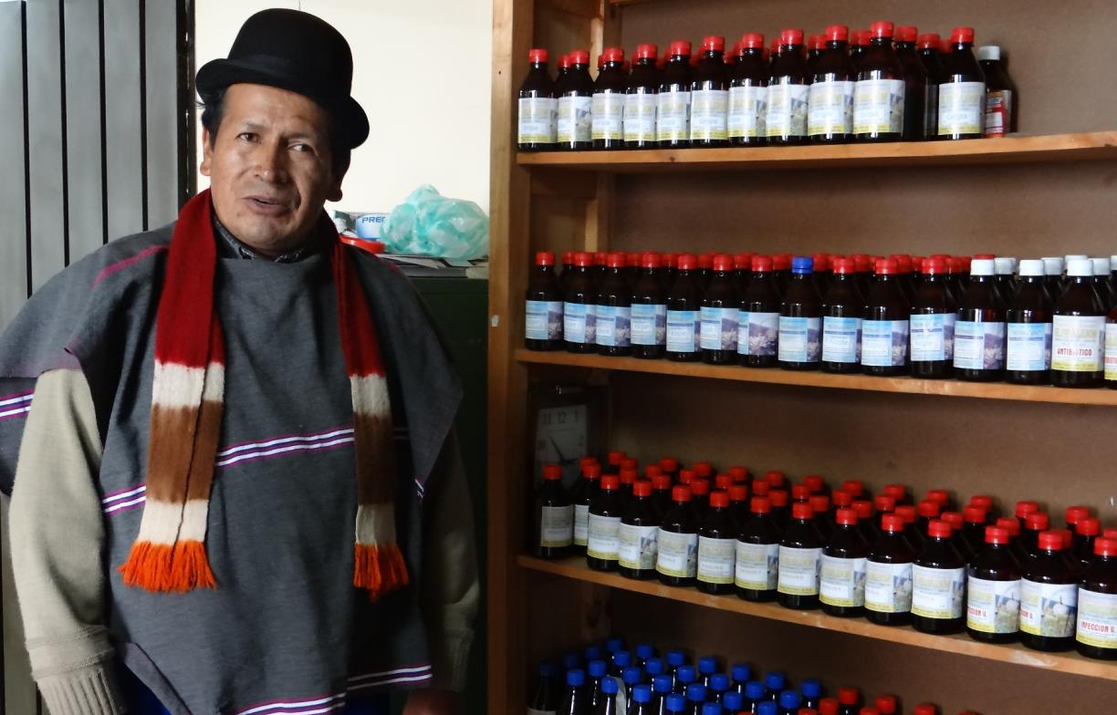

Case study: SHOPS provides TA to help innovative private health businesses access capital
While the private sector provides more than half of all healthcare in Africa, quality is low. In many countries, private health companies are unable to access the finance, including working capital, they need to improve and expand. Banks are unwilling to lend to the health sector and there is no venture capital available to foster innovation in business models.
SHOPS, a USAID project, provided technical assistance and grants to high potential private healthcare companies, helping them improve management, capacity, and quality so that they can attract the finance they need to scale.
SHOPS provided TA to healthcare companies so that they can better access bank lending and ultimately attract impact investment to expand. It worked with DCA to structure guarantees to increase health lending. It also facilitated linkages between private healthcare SMES, banks, and other potential investors.
SHOPs has worked with healthcare companies in 10 countries, including supporting DCAs in 5. SHOPS has helped mobilize almost $14 million in commercial financing to the health sector.
WHAT IS THE MODEL?
WHAT IS THE IMPACT?
Source: SHOPS(2014); USAID (2014): “Access to Finance and the Private Health Sector in USAID;” USAID (photo); Dalberg analysis.

Slide 68

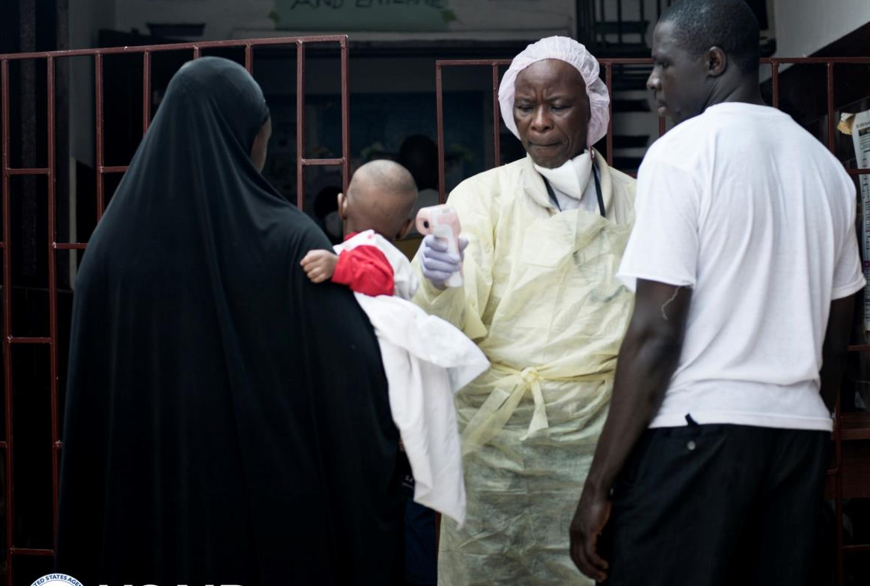
Case study: The Medical Credit Fund provides working capital and TA to healthcare SMEs across Africa
Medical Credit Fund (MCF) is a non-profit health investment fund seeking to strengthen the private healthcare sector in developing countries. Private healthcare companies, who provide the majority of health services in Africa, particularly to the poor, lack access to the finance they need, particularly working capital, to expand and improve delivery of care. MCF blends public and private capital to finance loans, guarantees, currency risk facilities, and TA to help private facilities strengthen operations and increase quality of care.
Donors, DFIs, foundations, and private investors, including USAID, IFC, BMGF, and Deutsche Bank, invest in a health investment fund that provides loans and guarantees to local banks to increase health lending, alongside TA grants to borrowers
Local banks provide loans to private healthcare SMEs, increasing their access to working capital
Health organizations scout and select eligible health SMEs and provide TA to strengthen management capacity
Healthcare SMEs, including hospitals, clinics, and dispensaries, provide more and better services to poor populations
Through MCF, over $7.5 million in loans have been disbursed to 968 healthcare SMEs in Tanzania, Kenya, Ghana, and Nigeria, with 97.7% loan repayment performance.
Collectively, these clinics serve more than 500,000 patients per month.
WHAT IS THE MODEL?
WHAT IS THE IMPACT?
Source: Neil Brandvold for USAID (photo)

Slide 69

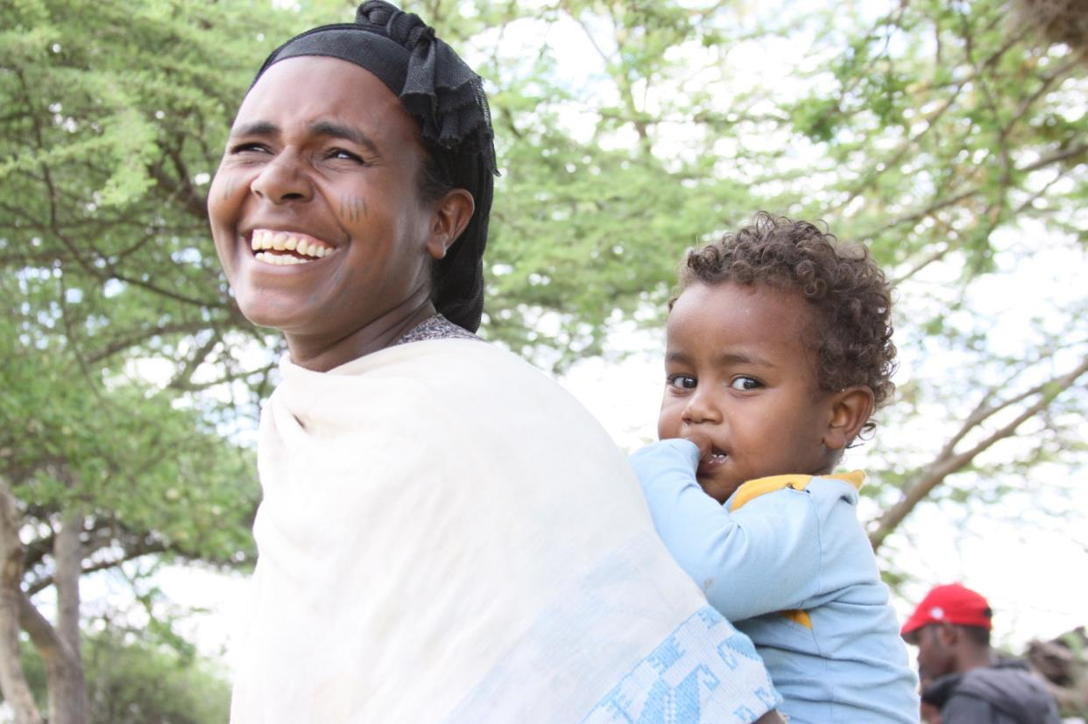

Case study: Ghana introduced a national health insurance scheme, financed by a trust fund and levy
In Ghana, high user fees cause low utilization of key services, particularly among the poor, and high out-of-pocket spending for those who do seek care.
In 2003, Ghana created the National Health Insurance Scheme to increase utilization of key services, decrease out-of-pocket spending, and improve health equity. The program’s benefits package covers 95% of the burden of disease, including maternity care.
The NHIS pools risk among the population to increase the efficiency and predictability of spending on healthcare. It is funded through a trust fund, the National Health Insurance Fund, which pools government and donor funds for allocation to the NHIS. The biggest revenue source (70%) to the fund is the health insurance levy, a 2.5% earmarked addition to the VAT. Individual premiums also finance the scheme, but certain populations, e.g. pregnant women, are exempt.
NHIS enrolled women were 40% more likely than non-enrolled women to have visited a clinic in the past year, and 83% more likely to have stayed overnight in a hospital. However, only 35% of the population has enrolled in the NHIS to date, and significant reforms are needed to improve coverage and equity.
WHAT IS THE MODEL?
WHAT IS THE IMPACT?
Source: UHCC (2013): “Ten years of the NHIS in Ghana;” Blanchet et al. (2012): “The effect of Ghana’s NHIS on healthcare utilization;” USAID (photo); Dalberg analysis.

Slide 70
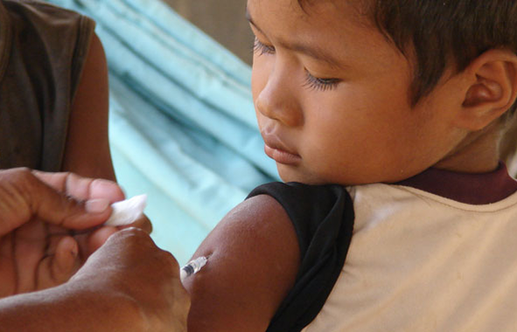

Case study: Cambodia’s Health Equity Funds increase health access for the poorest
Health equity funds are autonomous, district-based schemes that reimburse health facilities for the cost of user-fee exemptions, which also include costs of transportation and meals. In 1996, Cambodia decided to exert a user fee in public facilities (formerly, health care was free). While this was intended to improve quality of health services by infusing capital into the health system, user fees deterred the poor from seeking care. To address this issue, health equity funds were structured to enable the poor to access free or subsidized healthcare while wealthier populations still paid user fees.
Donors, including USAID, DFID, and UNFPA pool resources into regional trust funds alongside domestic national health budget allocated to the funds
Health providers get reimbursed for providing services to the poor
Poor patients are exempt from user fees and reimbursed for transport and other expenses, facilitating greater access to and utilization of health services
By 2010, HEFs covered the poor population in over half of health districts in Cambodia. Literature concludes that HEFs appear to reduce impoverishment due to health costs and improve staff incentives and attitudes towards the poor
HEFs, by nature, rely heavily on external funds, and have high administrative overhead costs, and thus may not ultimately be sustainable
WHAT IS THE MODEL?
WHAT IS THE IMPACT?
Source: Kingdom of Cambodia (2009): “Implementation of the Health Equity Fund Guideline;” Health Policy and Health Finance Knowledge Hub (2010): “A comprehensive review of the literature on health equity funds in Cambodia and annotated bibliography;” International Journal of Planning Management (2007): “A sustainability assessment of a health equity fund initiative in Cambodia;” AllAfrica (2014): “Ellen Considers Health Equity Fund;” CDC (photo); Dalberg analysis.

Slide 71

Case study: Ghanaian national fee exemption policy increased facility deliveries among the poor
The government of Ghana instituted an exemptions policy for delivery fees in 2004. The poor lack the ability to pay for the direct and indirect costs of healthcare, lowering utilization of key services such as facility-based delivery. At the same time, healthcare providers lack incentives to treat the poor, who cannot afford to pay in full for services. Ghana’s fee exemption policy is part of a growing movement to reduce financial barriers to healthcare. Similar policies have been implemented in Burundi, Zambia, Burkina Faso, Kenya, Liberia, and South Sudan.
Women, especially poor women, are able to give birth in a facility without paying for the direct costs of delivery
Public and private providers were reimbursed for all intrapartum care costs, first through a debt relief fund, and then later through a national health insurance scheme
The policy increased utilization of facility-based delivery services significantly, particularly among the poor. The percentage of the poorest women giving birth in a facility nearly doubled in the Volta region.
Out-of-pocket spending on maternal care decreased across all wealth quintiles, and the proportion of households driven into extreme poverty by delivery costs was nearly halved
Learn more by clicking here
WHAT IS THE MODEL?
WHAT IS THE IMPACT?
Source: USAID (photo).

Slide 72
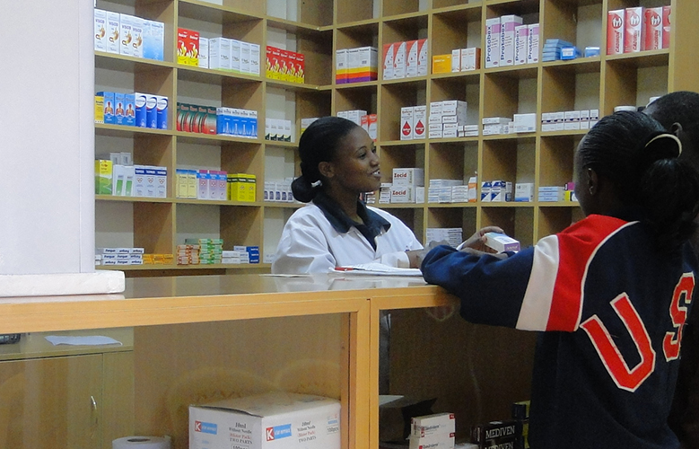



Case study: Linda Jamii offers a mass-market, mobile-based microinsurance product
Limited ability to pay prevents Kenyan families from accessing the healthcare they need, especially primary and preventive care. Out-of-pocket spending accounts for 45% of healthcare expenditure in Kenya, and 97% of Kenyans are uninsured; many can’t afford the high premiums of existing schemes. To solve this problem , Britam, Changamka, and Safaricom, with the support of Population Services International, launched a micro-insurance and savings product for health.
Consumers save and pay premiums for a micro health insurance model through an M-PESA collection platform, which lowers the administration costs as well as barriers to uptake
Linda Jamii insurance covers inpatient and outpatient services (including maternity), as well as wages lost during hospitalization, increasing utilization of key EPCMD services and decreasing catastrophic out-of-pocket spending
Linda Jamii’s 36,000 subscribers can access healthcare, including maternity care, at over 600 Kenyan hospitals. In addition to increasing the efficiency of out-of-pocket payments, insurers are incentivized to teach and encourage for health-seeking behaviors such as better diets, safer sex, and exclusive breastfeeding. However, microinsurance may not be suitable for the poorest of the poor, who cannot afford to pay even small premiums for healthcare.
WHAT IS THE MODEL?
WHAT IS THE IMPACT?
Source: WHO Global Health Expenditure Country Database; http://changamka.co.ke/about/about-changamka; CGAP Global Landscape Digital Finance Plus; Dalberg analysis; Walter Lamberson/Miliki Afya (Photo)

